Slide 2

Maryam Khalaf Mereed
O2C Cycle
Create Customer
Create Payment Term
Create Invoice

Slide 3
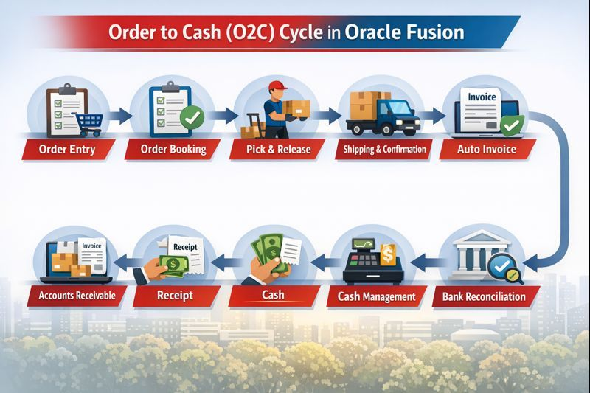
Maryam Khalaf Mereed
O2C Cycle

Slide 4
Maryam Khalaf Mereed
O2C Cycle

Slide 5
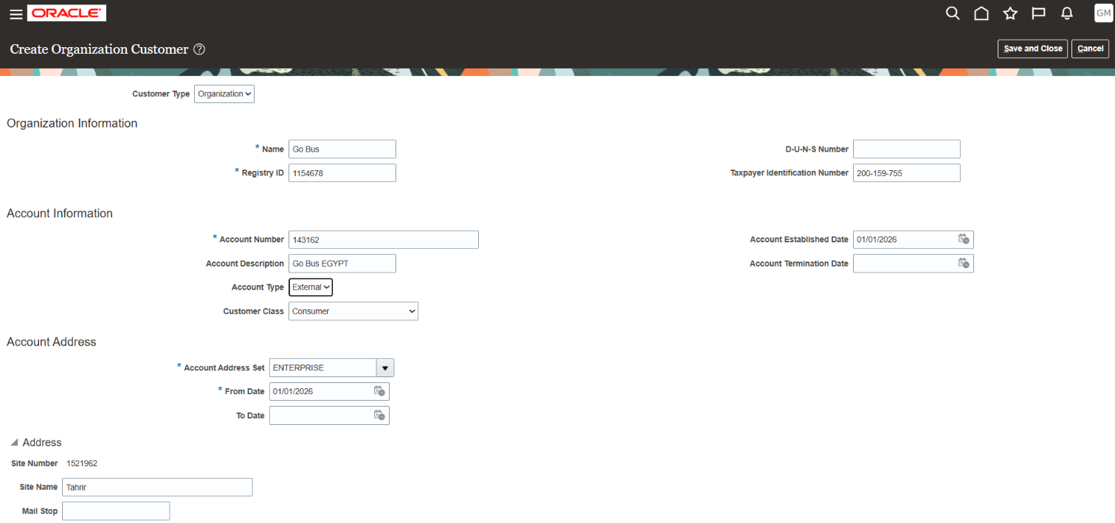
Maryam Khalaf Mereed
Create Customer

Slide 6
Maryam Khalaf Mereed
Create Customer

Slide 7
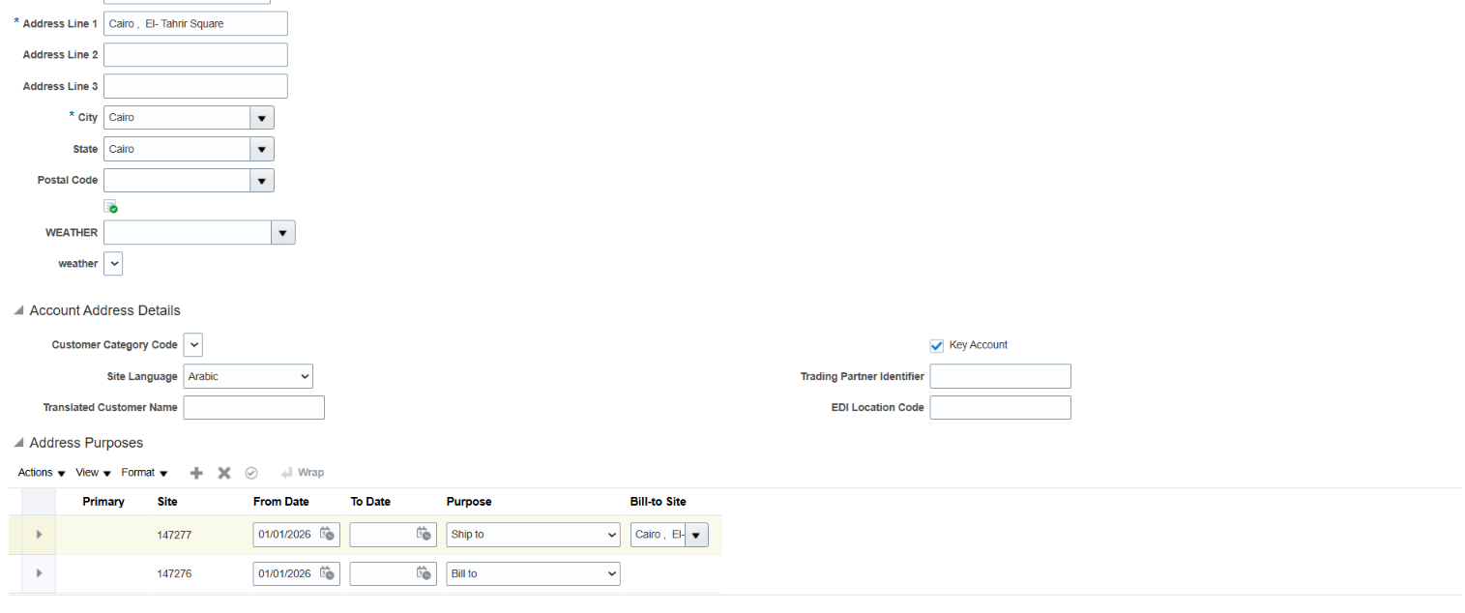
Maryam Khalaf Mereed
Create Customer

Slide 8
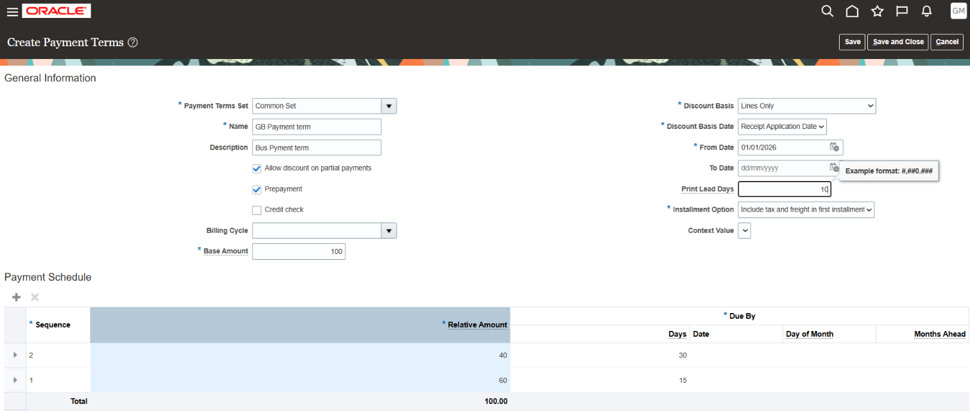
Maryam Khalaf Mereed
Create Payment Term

Slide 9
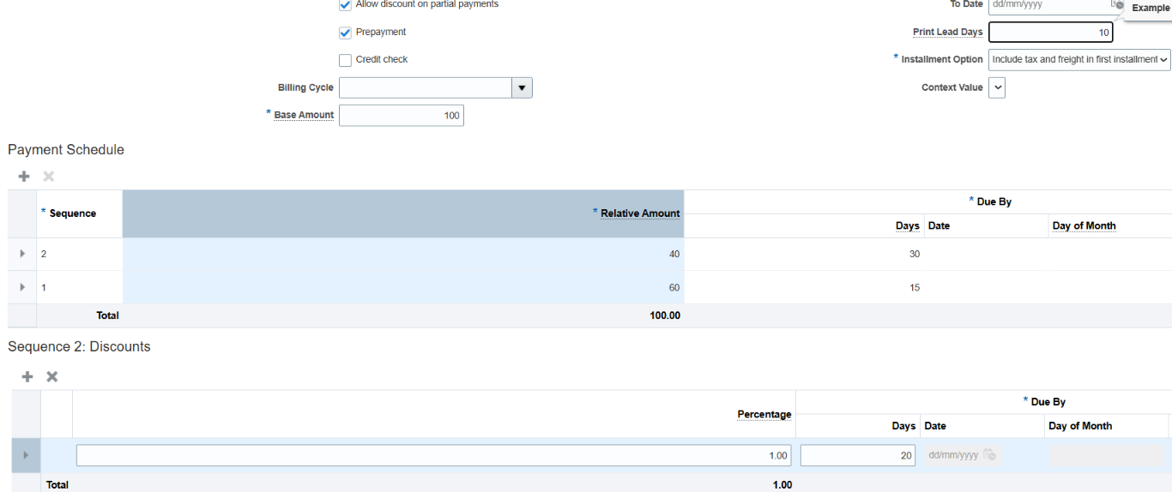
Maryam Khalaf Mereed
Create Payment Term

Slide 10
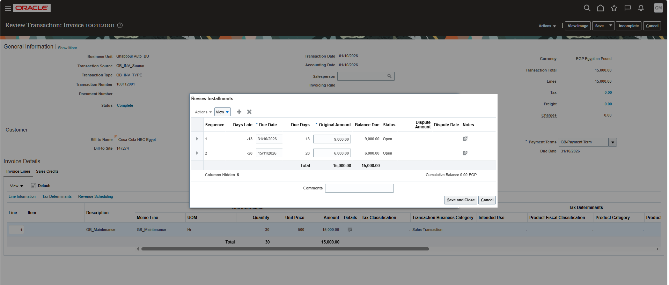
Maryam Khalaf Mereed
Review Instalments

Slide 11
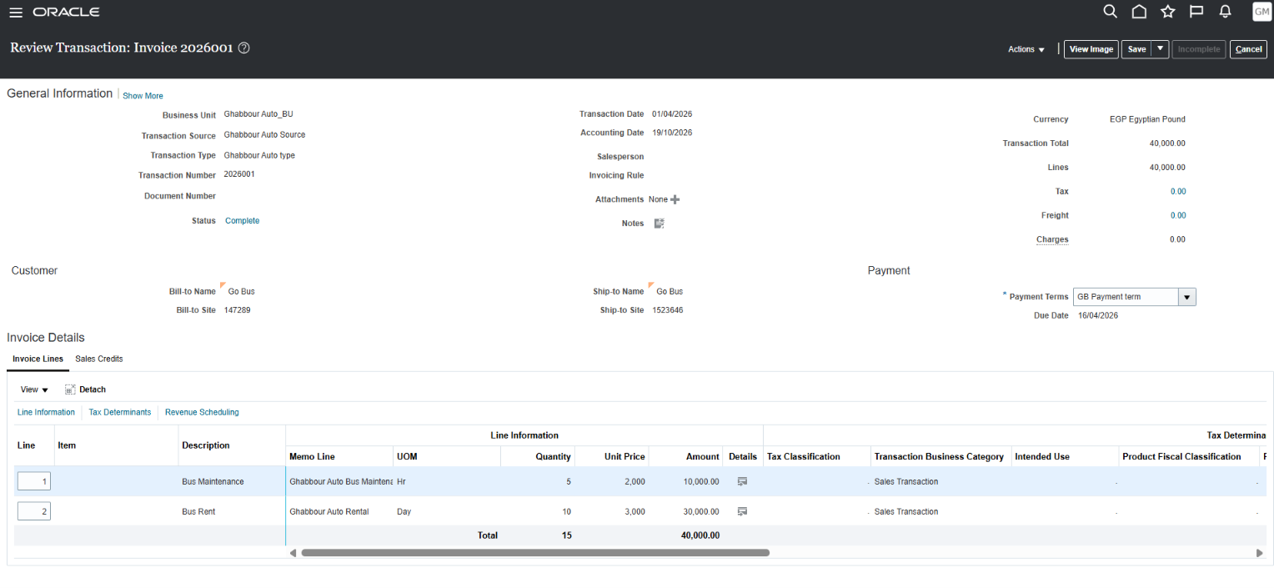
Maryam Khalaf Mereed
Review Instalments

Slide 12
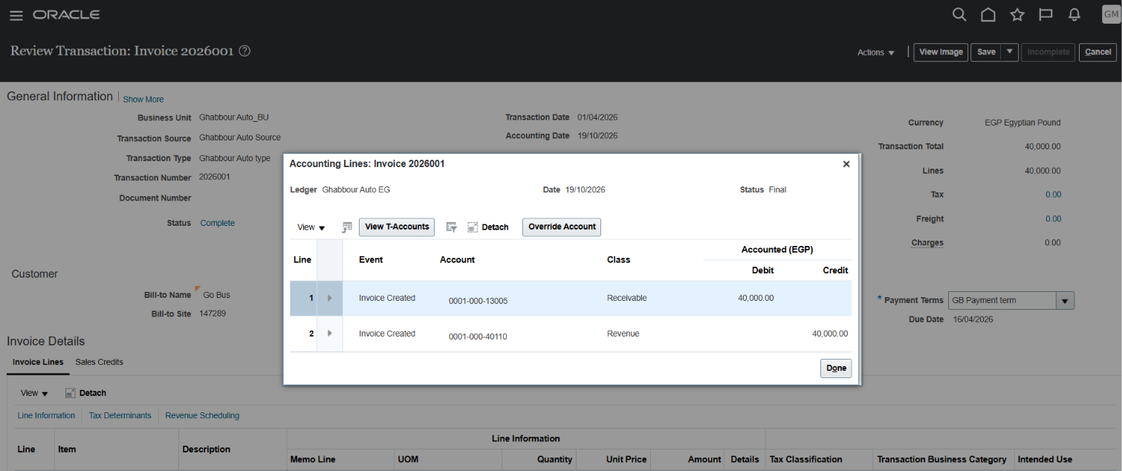
Maryam Khalaf Mereed
Invoice Journal

Slide 13
Mahmoud Mohamed Ahmed
Create Credit Note
Approval Limit
(ADJ – Write Off – Refund)
Receivable Activity
ADJ

Slide 14
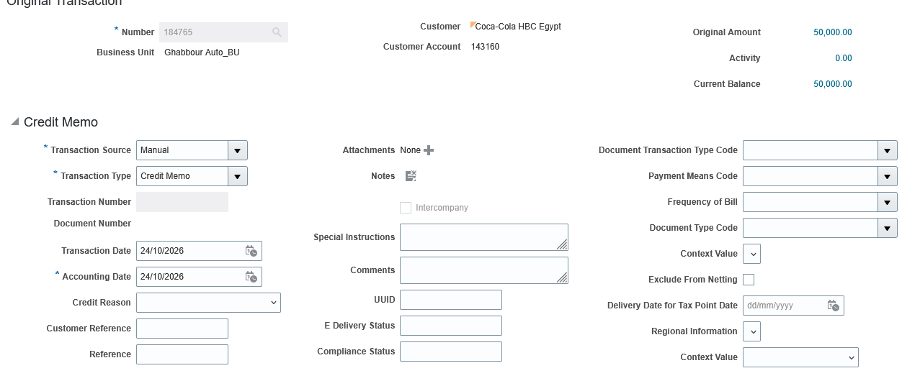
Mahmoud Mohamed Ahmed
Create Credit Note

Slide 15
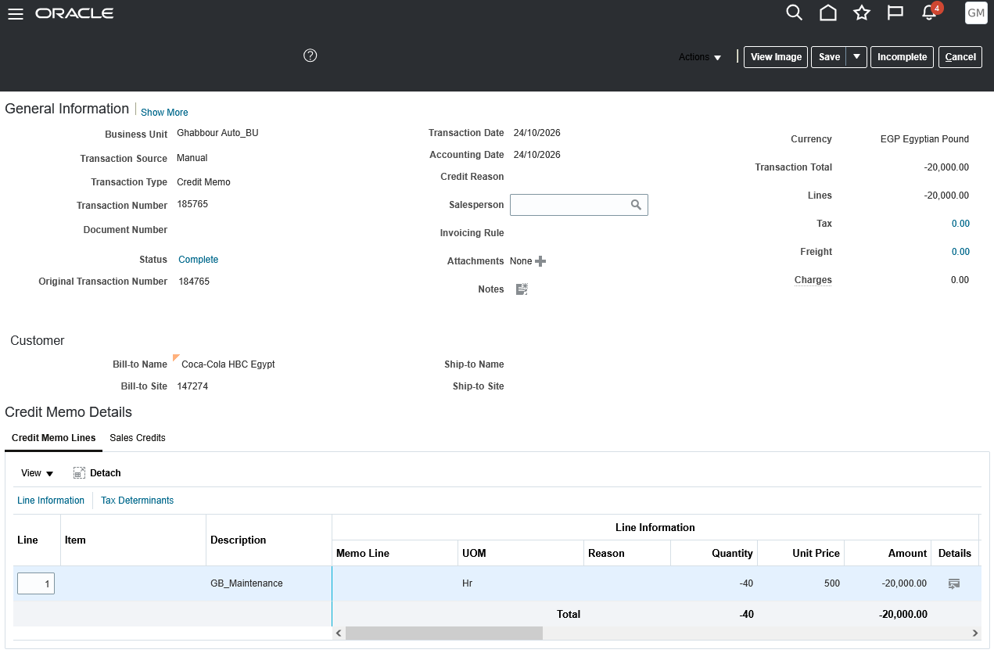
Mahmoud Mohamed Ahmed
Create Credit Note

Slide 16
Mahmoud Mohamed Ahmed
Create Credit Note

Slide 17
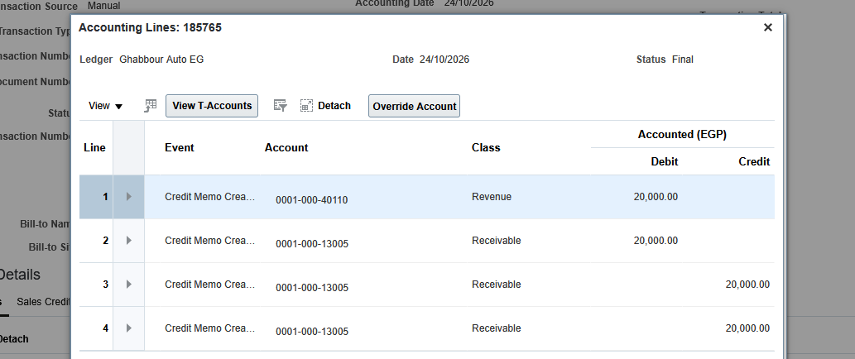
Mahmoud Mohamed Ahmed
Credit Note Journal

Slide 18
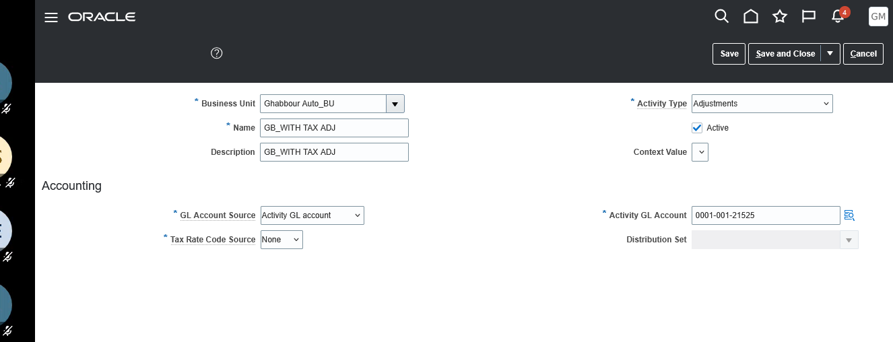
Mahmoud Mohamed Ahmed
Receivable Activity - ADJ

Slide 19
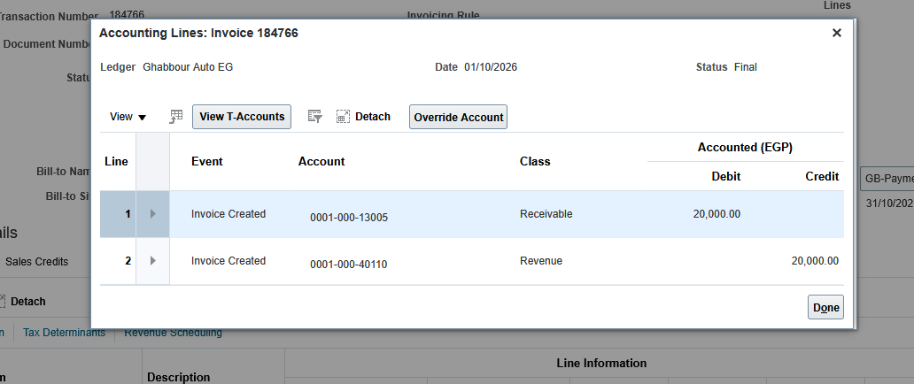
Mahmoud Mohamed Ahmed
Receivable Activity - ADJ

Slide 20
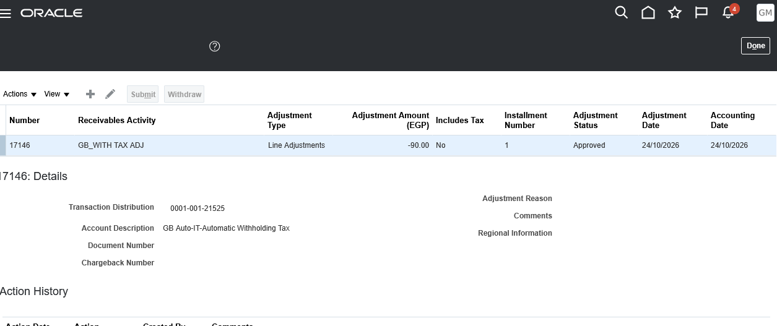
Mahmoud Mohamed Ahmed
Receivable Activity - ADJ

Slide 21
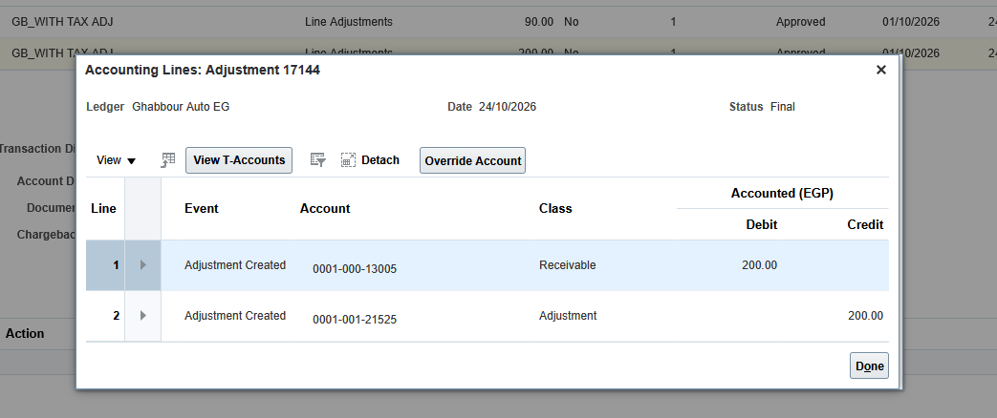
Mahmoud Mohamed Ahmed
Receivable Activity - ADJ

Slide 22
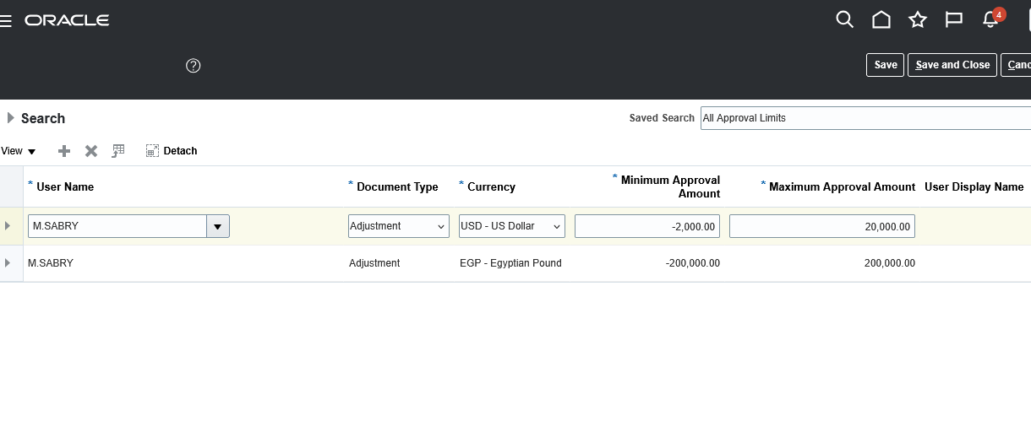
Mahmoud Mohamed Ahmed
Approval Limit

Slide 23
Ahmed Rabiea Abdelhalim
Receivable Activity
Earned Discount
Unearned Discount
Write Off
Refund

Slide 24
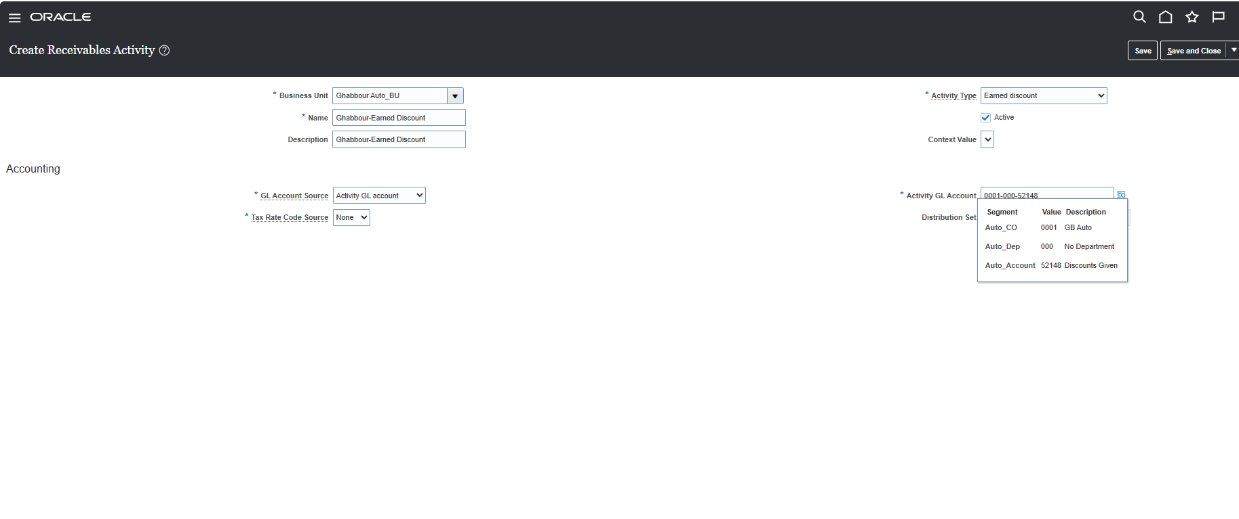
Ahmed Rabiea Abdelhalim
Earned Discount

Slide 25
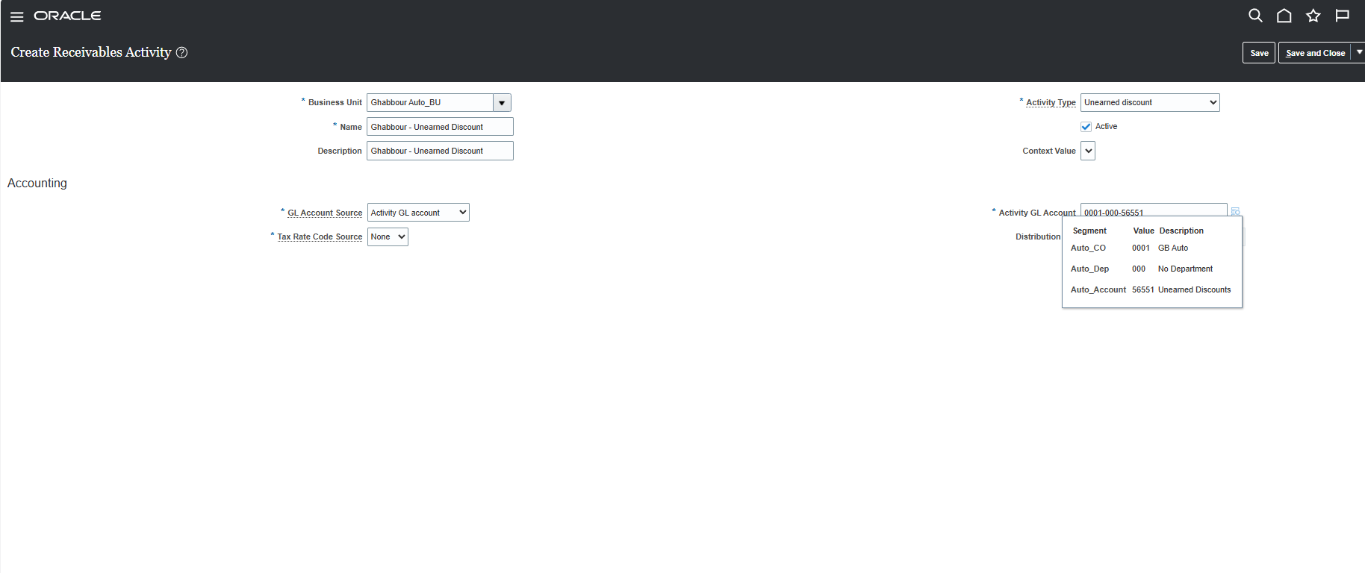
Ahmed Rabiea Abdelhalim
Unearned Discount

Slide 26
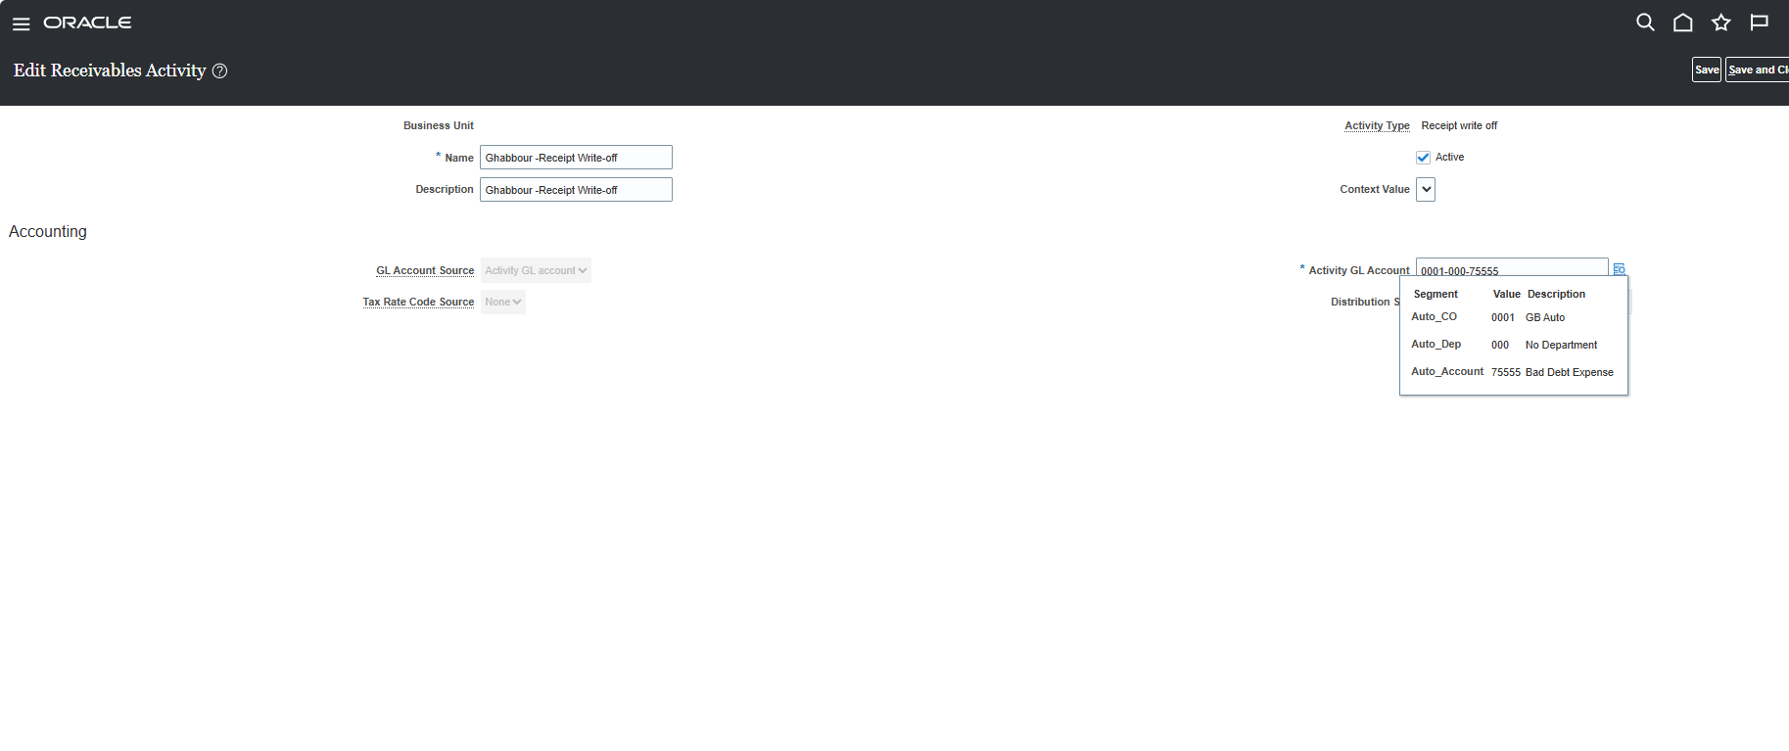
Ahmed Rabiea Abdelhalim
Write Off

Slide 27
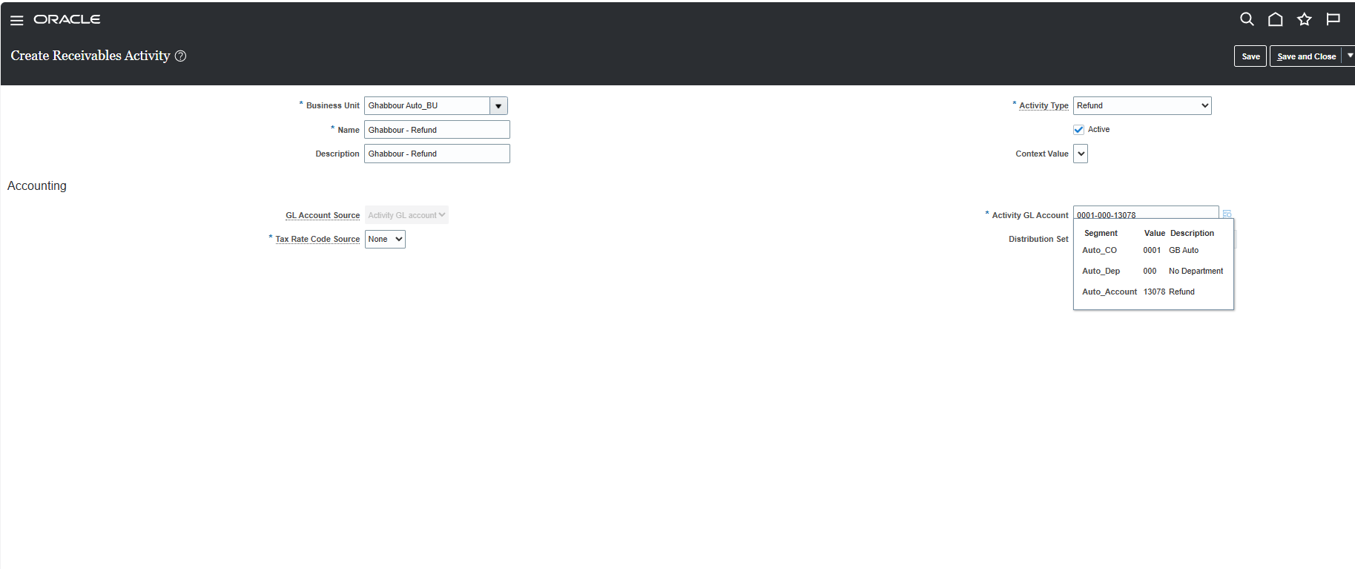
Ahmed Rabiea Abdelhalim
Refund

Slide 28
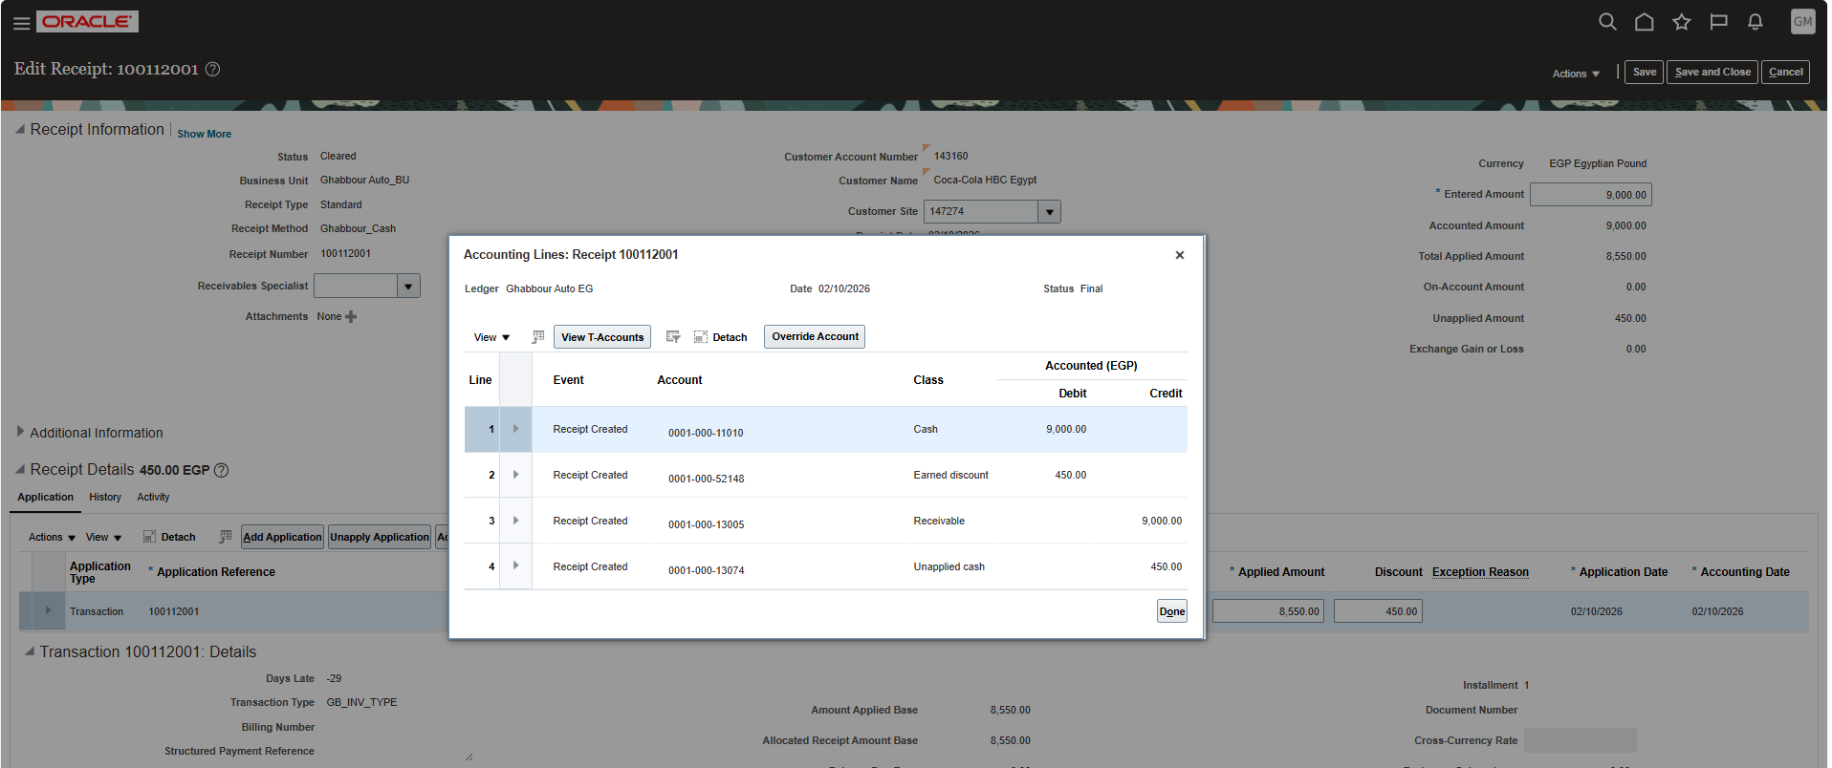
Ahmed Rabiea Abdelhalim
Earned Discount

Slide 29
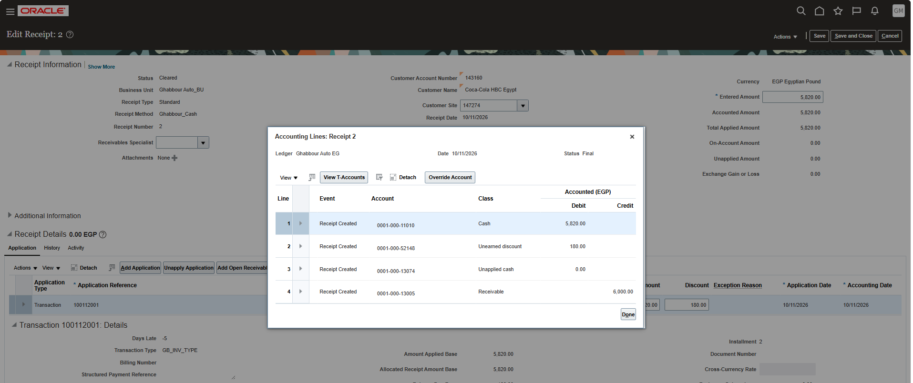
Ahmed Rabiea Abdelhalim
Unearned Discount

Slide 30
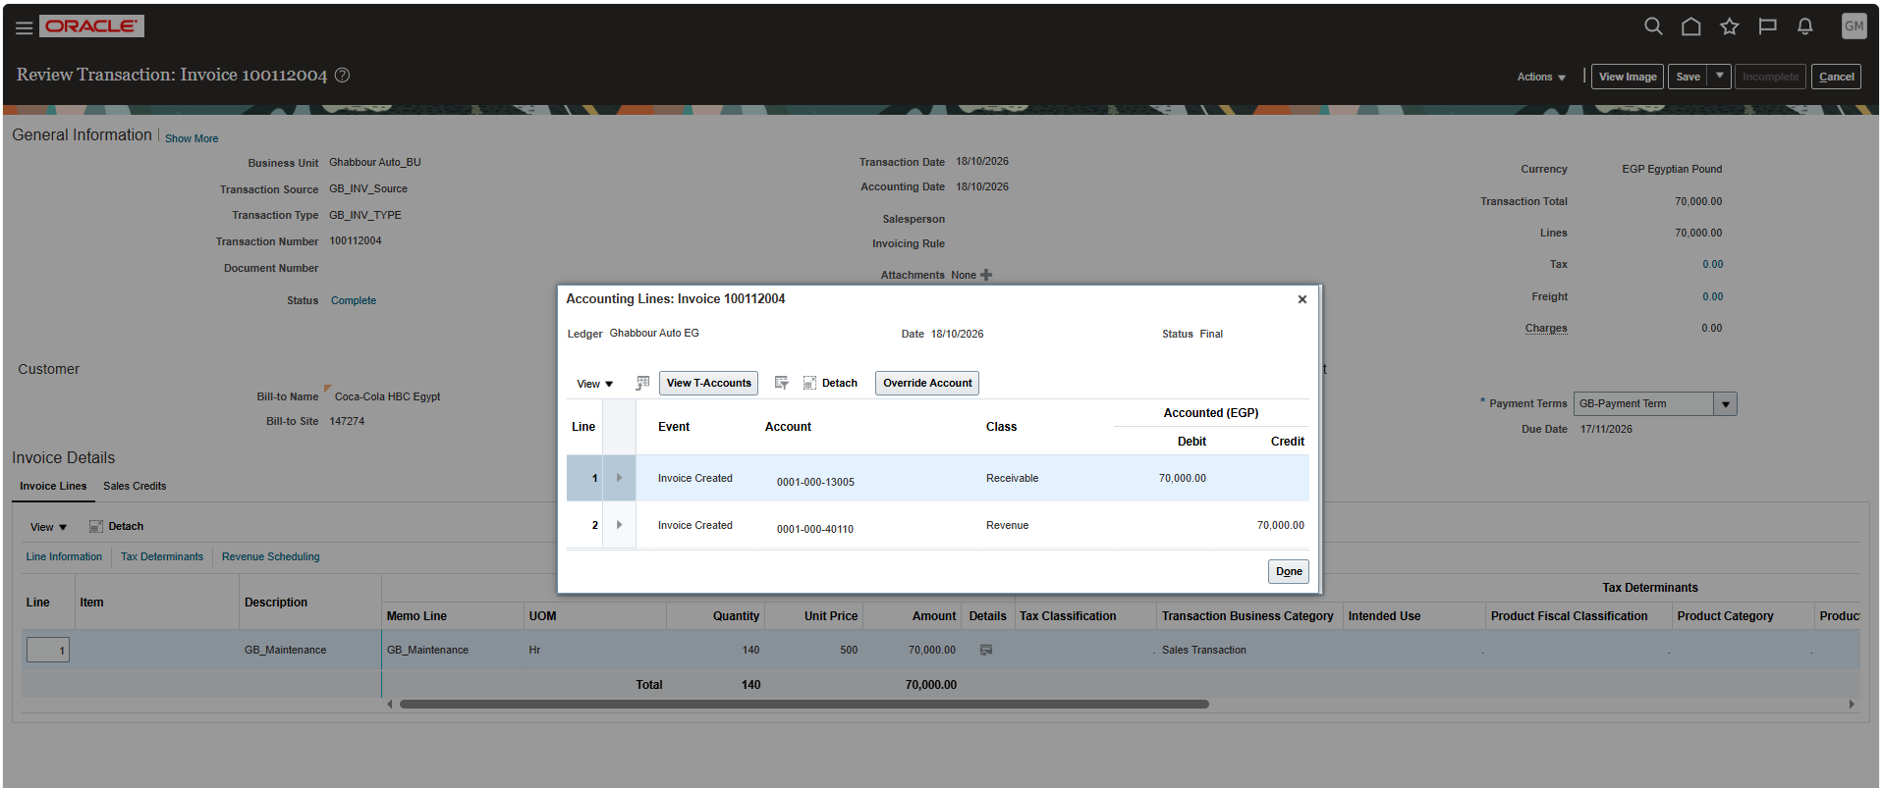
Ahmed Rabiea Abdelhalim
Write Off

Slide 31
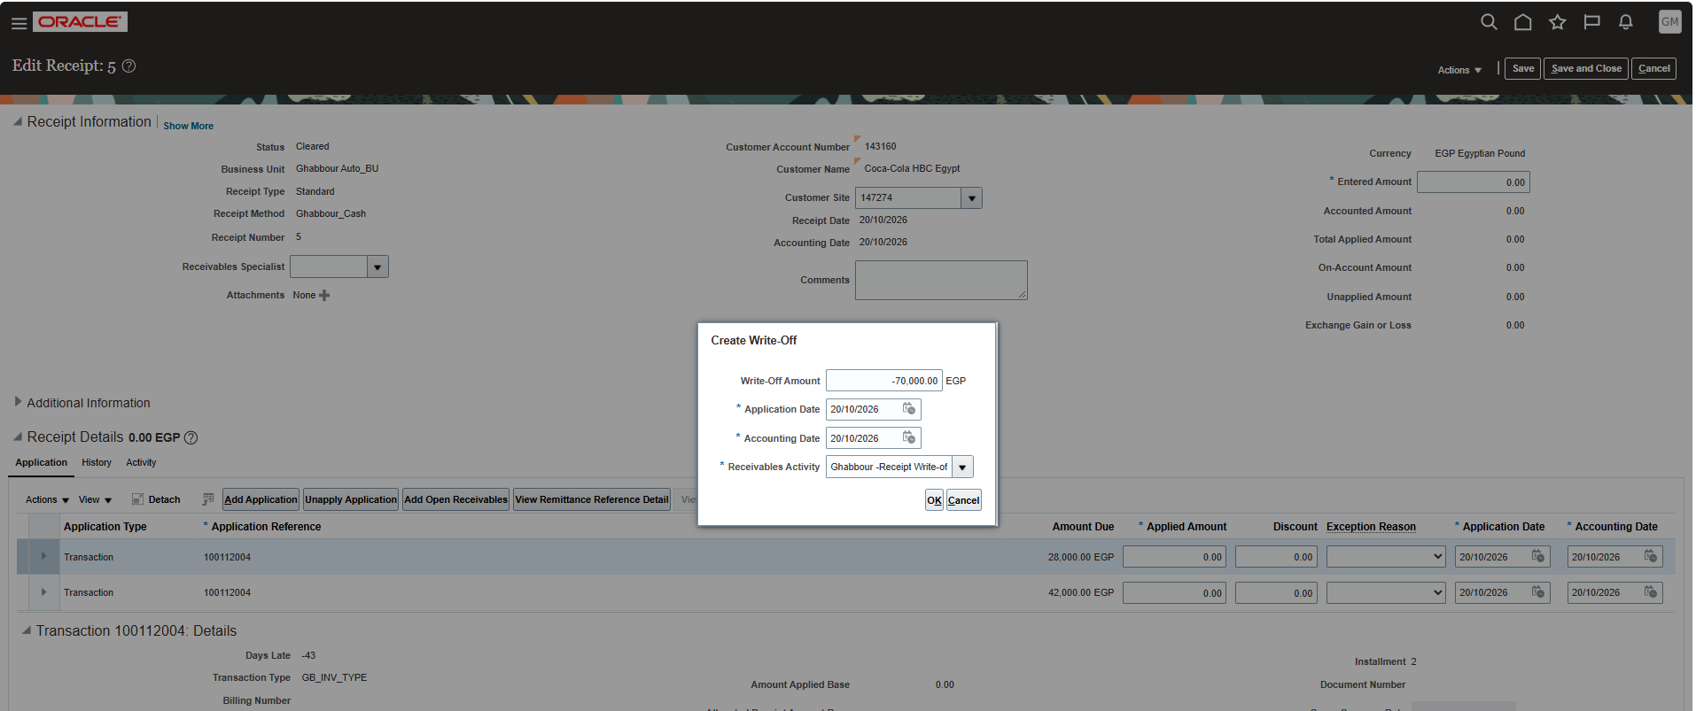
Ahmed Rabiea Abdelhalim
Write Off

Slide 32
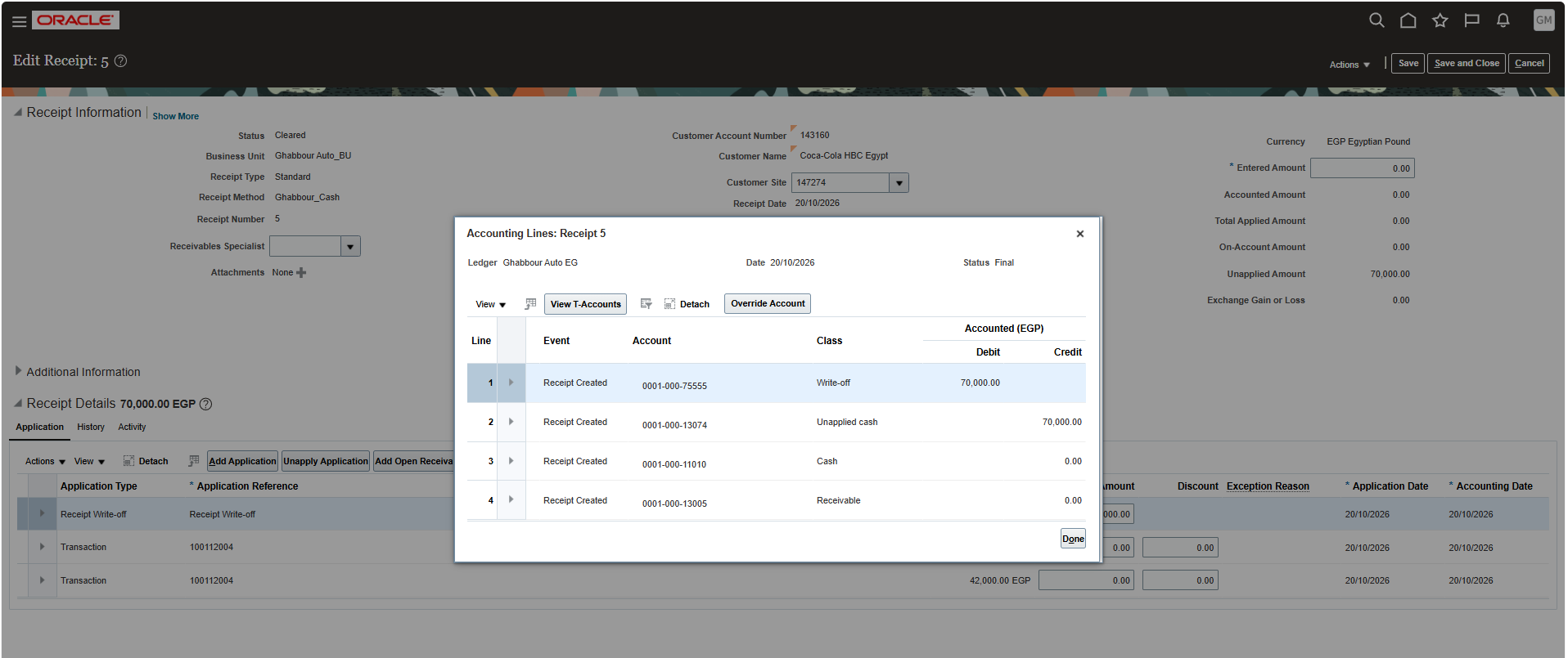
Ahmed Rabiea Abdelhalim
Write Off

Slide 33
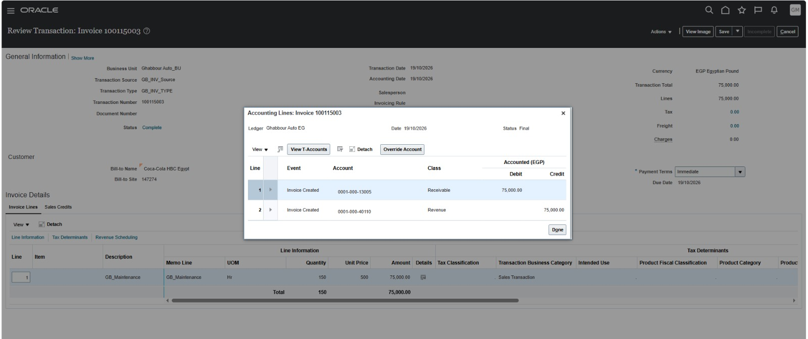
Ahmed Rabiea Abdelhalim
Refund

Slide 34
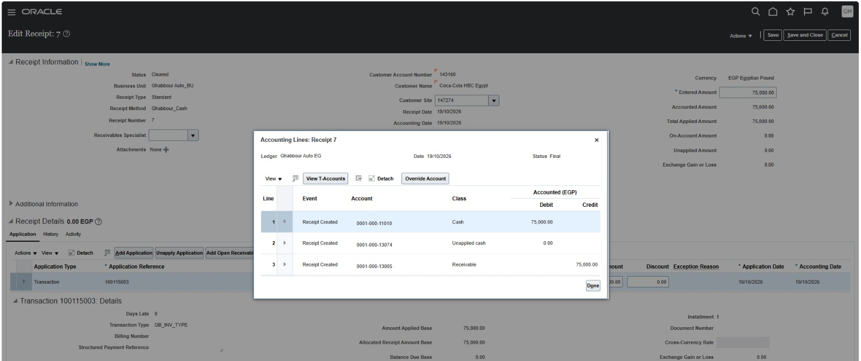
Ahmed Rabiea Abdelhalim
Refund

Slide 35
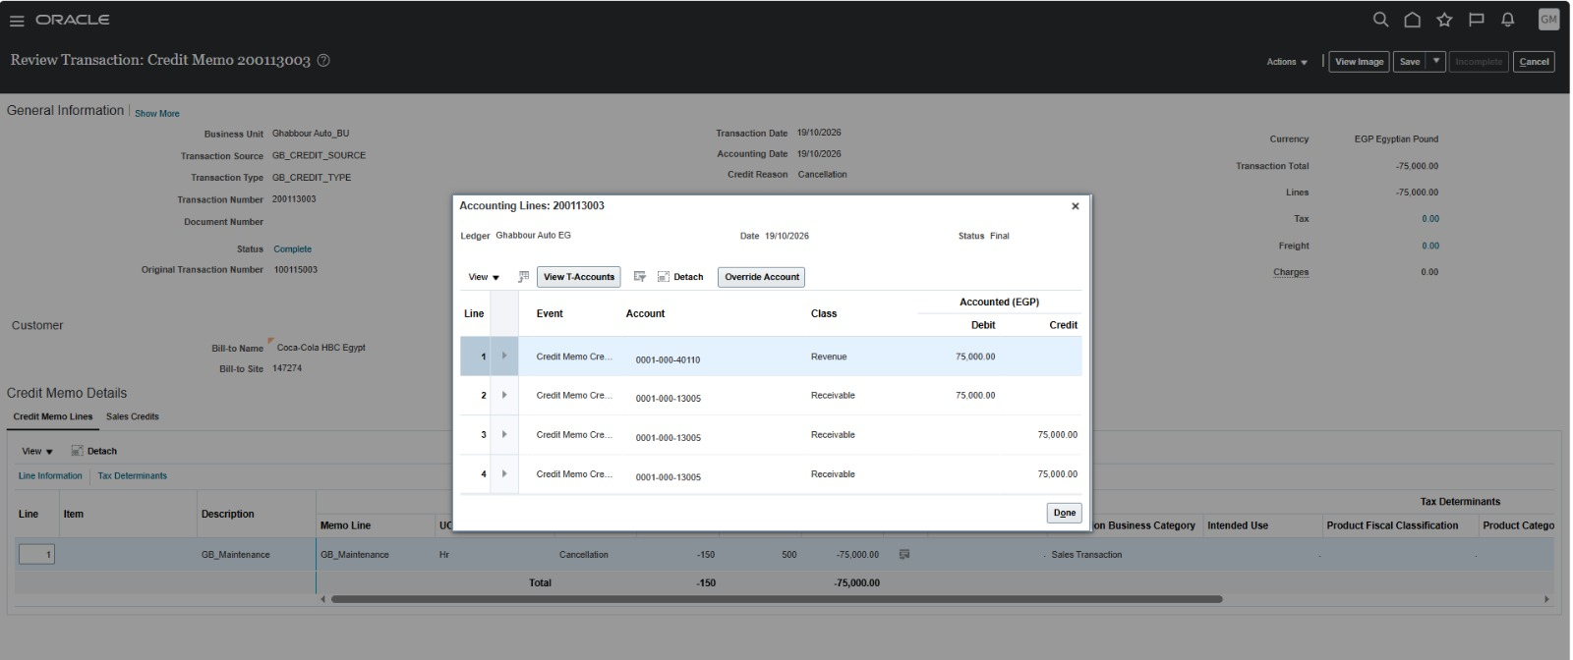
Ahmed Rabiea Abdelhalim
Refund

Slide 36
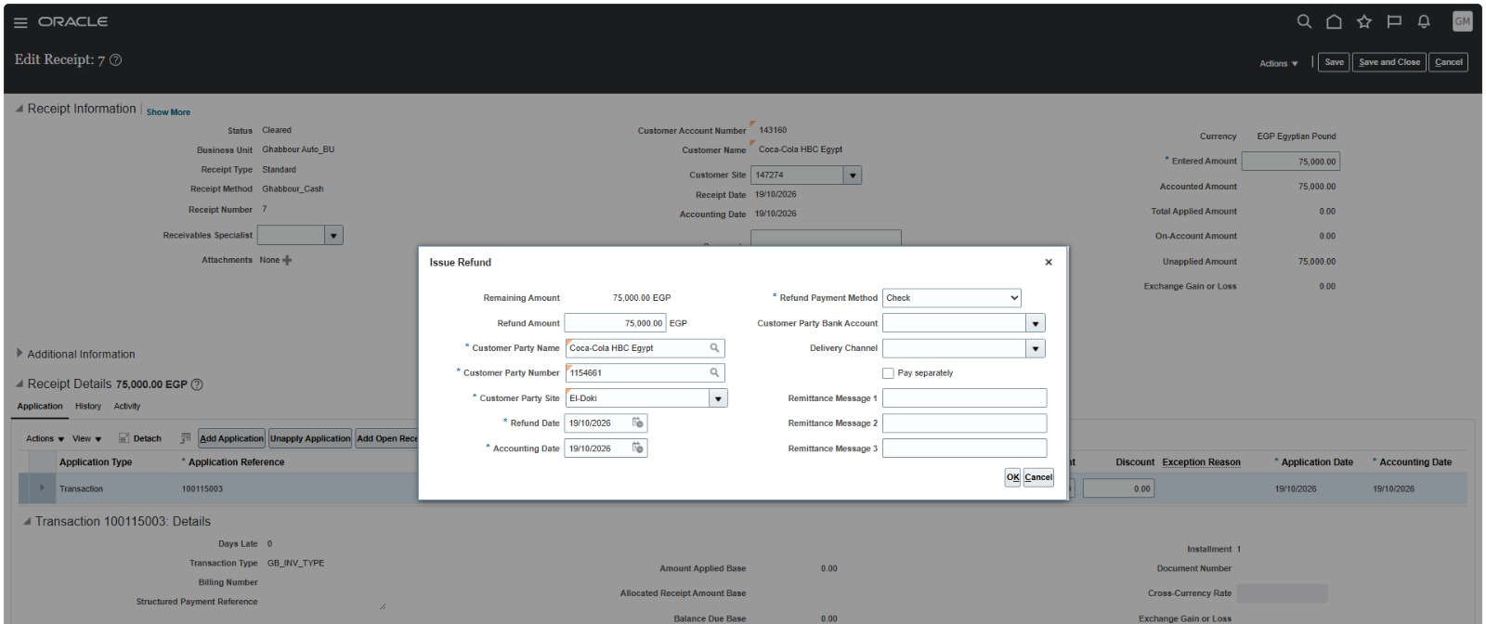
Ahmed Rabiea Abdelhalim
Refund

Slide 37
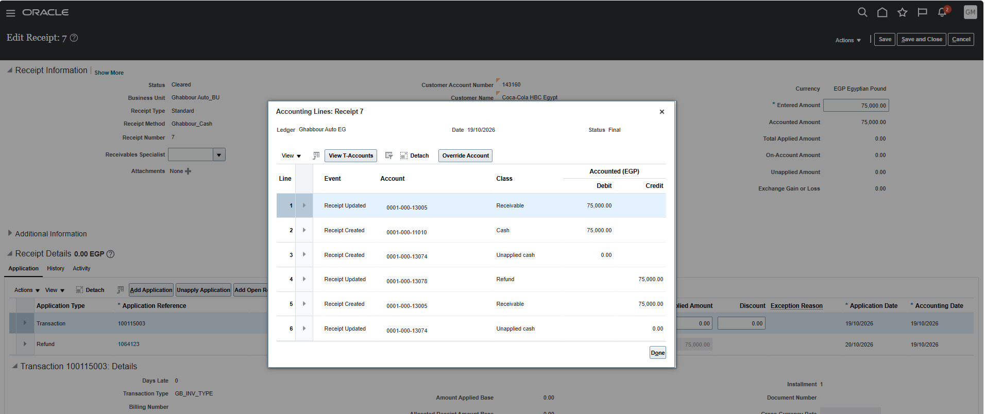
Ahmed Rabiea Abdelhalim
Refund

Slide 38
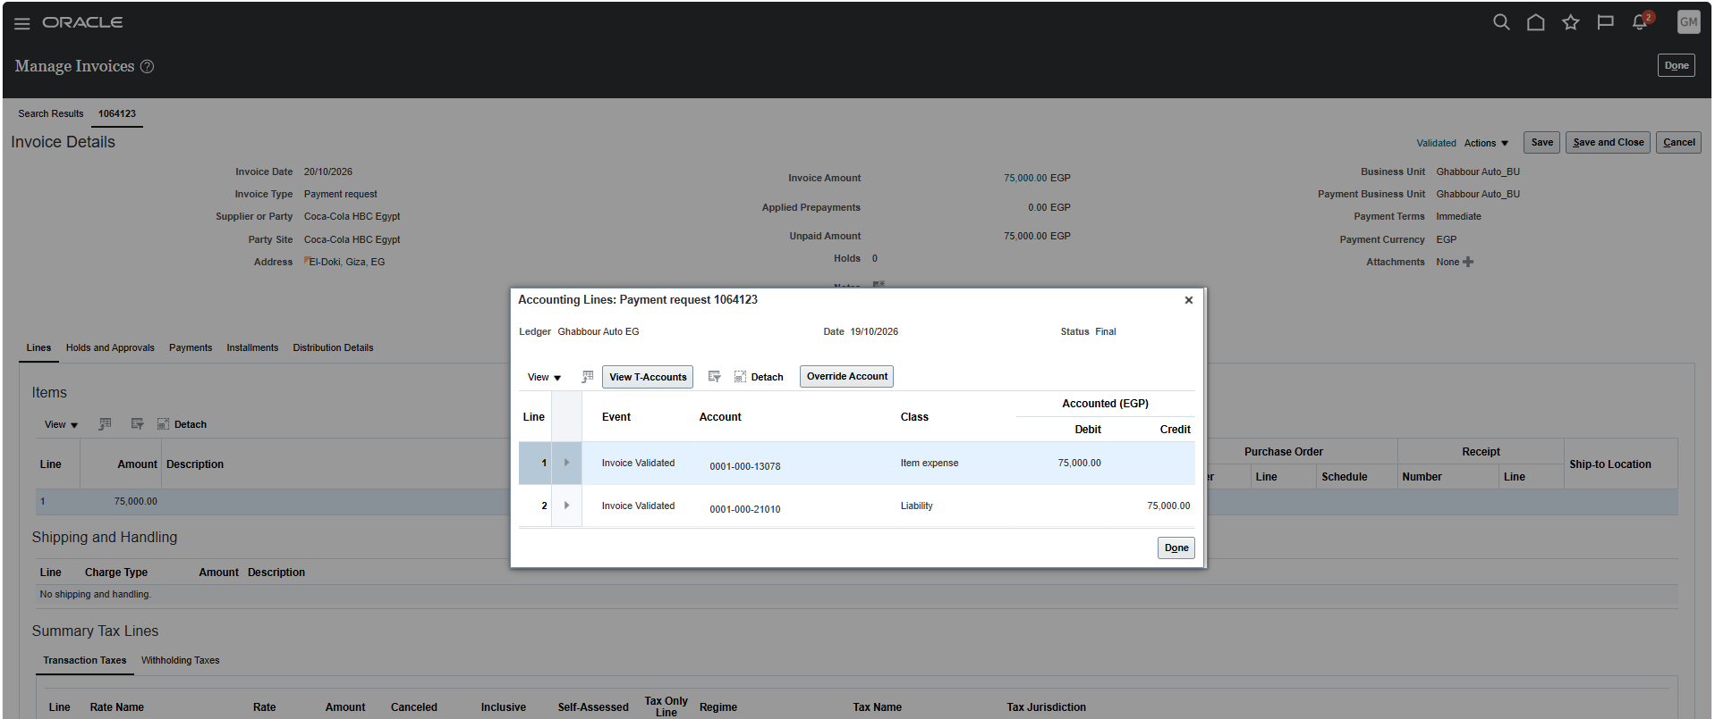
Ahmed Rabiea Abdelhalim
Refund

Slide 39
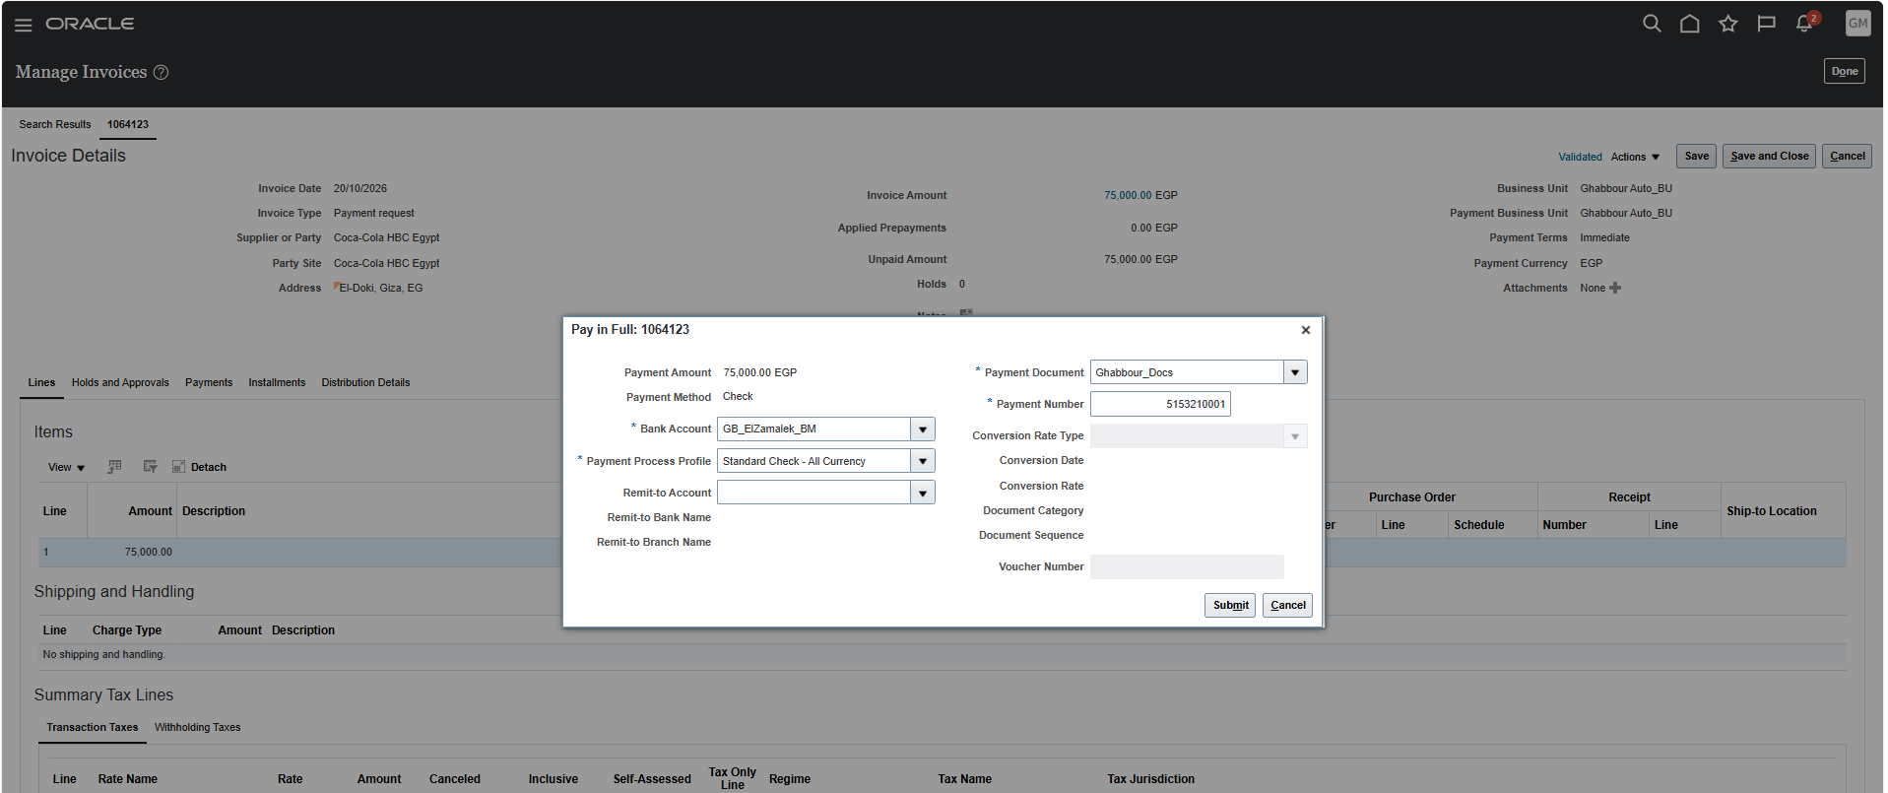
Ahmed Rabiea Abdelhalim
Refund

Slide 40
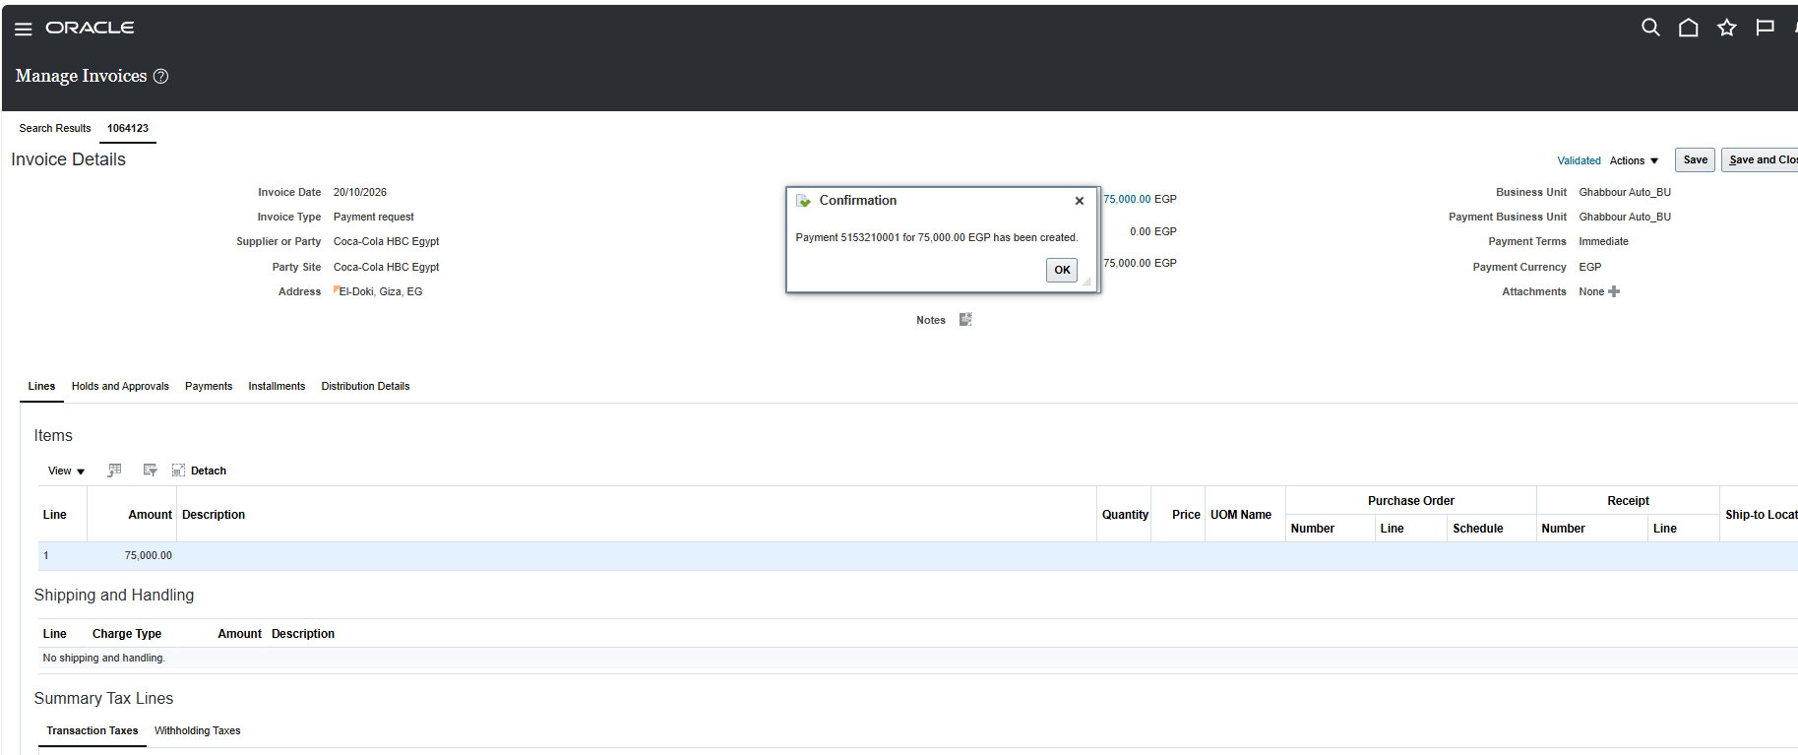
Ahmed Rabiea Abdelhalim
Refund

Slide 41
Ahmed Mahmoud Salah
Define Bank
Miscellaneous cash
Receipt method
Create Receipt
Report

Slide 42
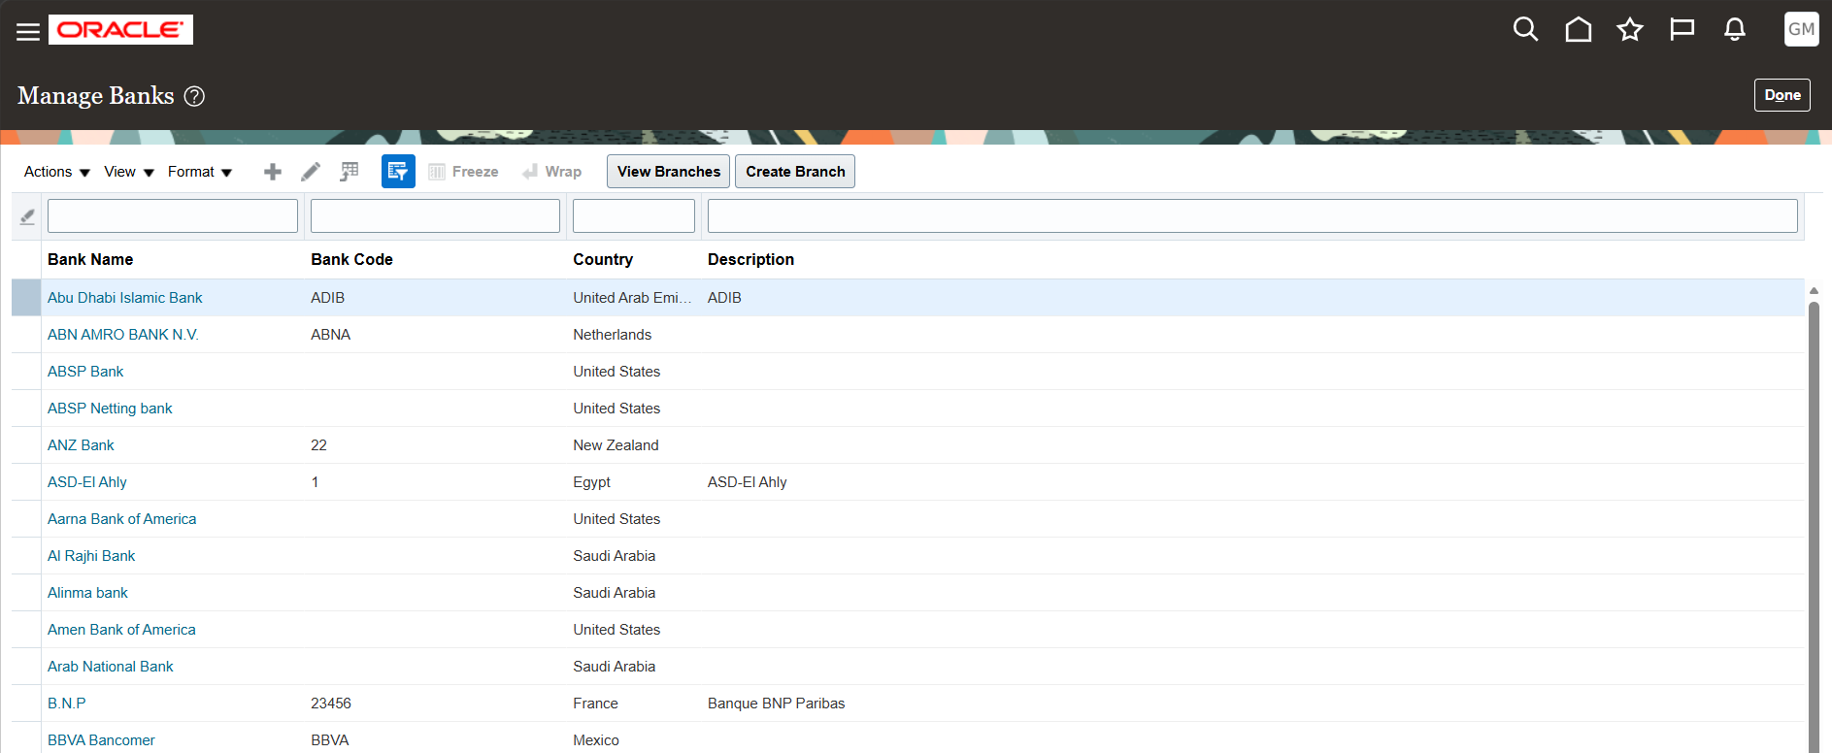
Ahmed Mahmoud Salah
Create Bank

Slide 43
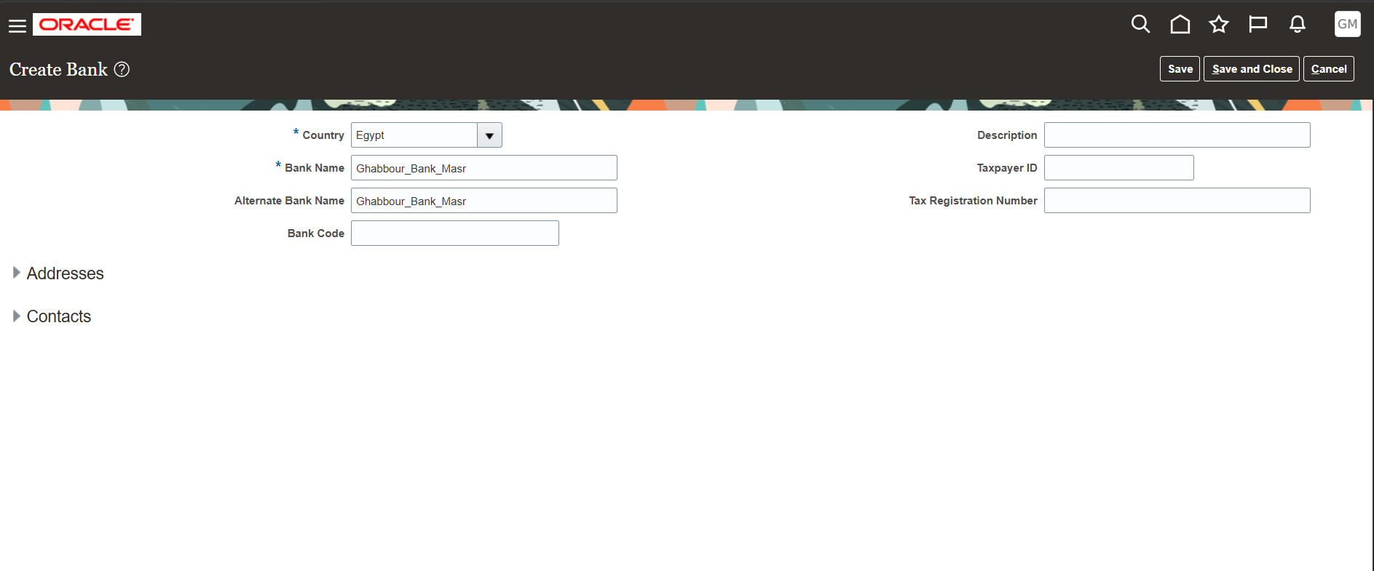
Ahmed Mahmoud Salah
Create Bank Account

Slide 44
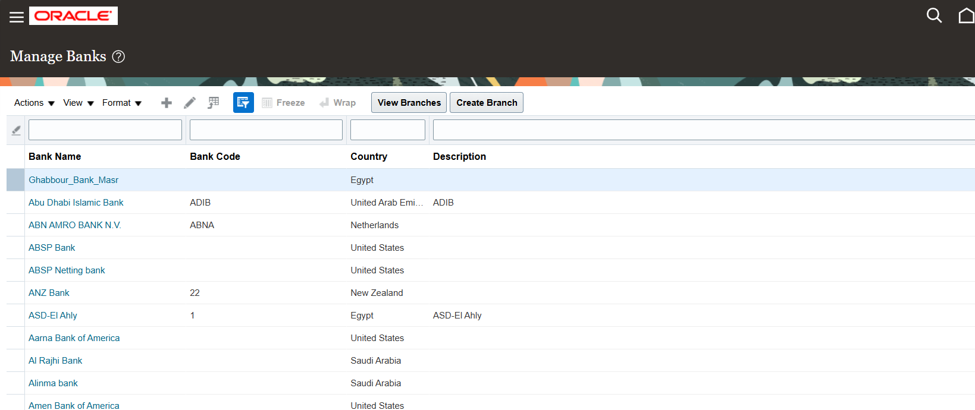
Ahmed Mahmoud Salah
Create Branch Bank

Slide 45
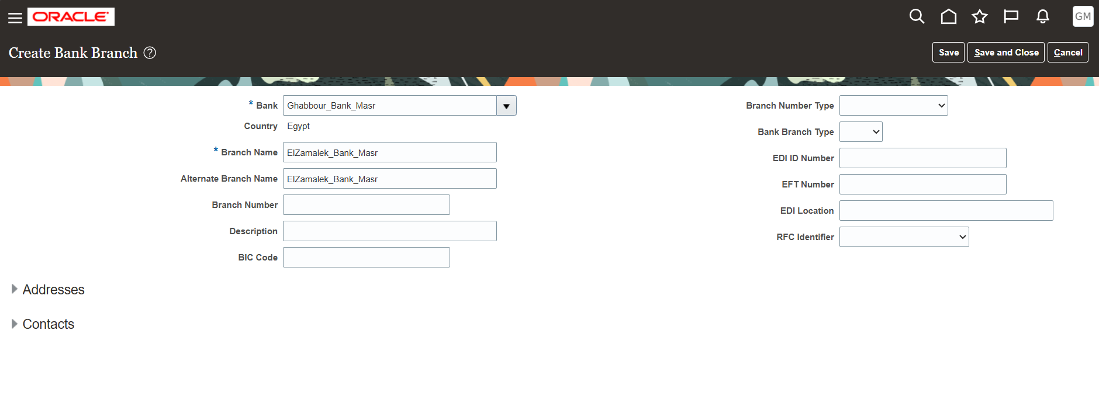
Ahmed Mahmoud Salah
Create Branch Bank

Slide 46
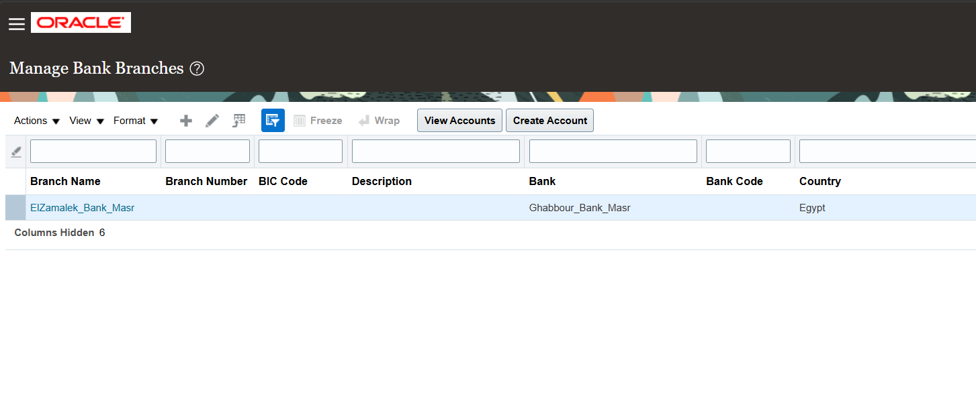
Ahmed Mahmoud Salah
Create Account

Slide 47
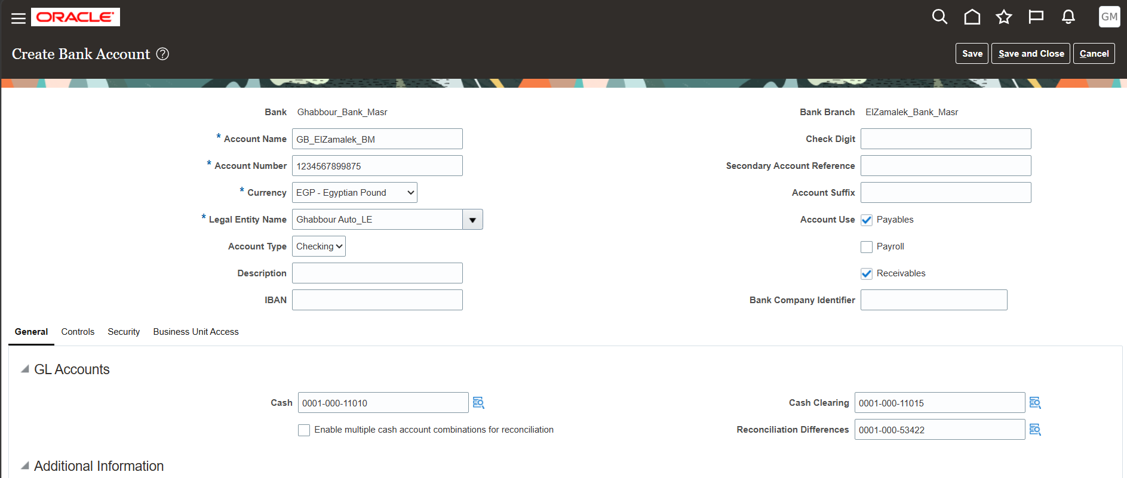
Ahmed Mahmoud Salah
Create Account

Slide 48
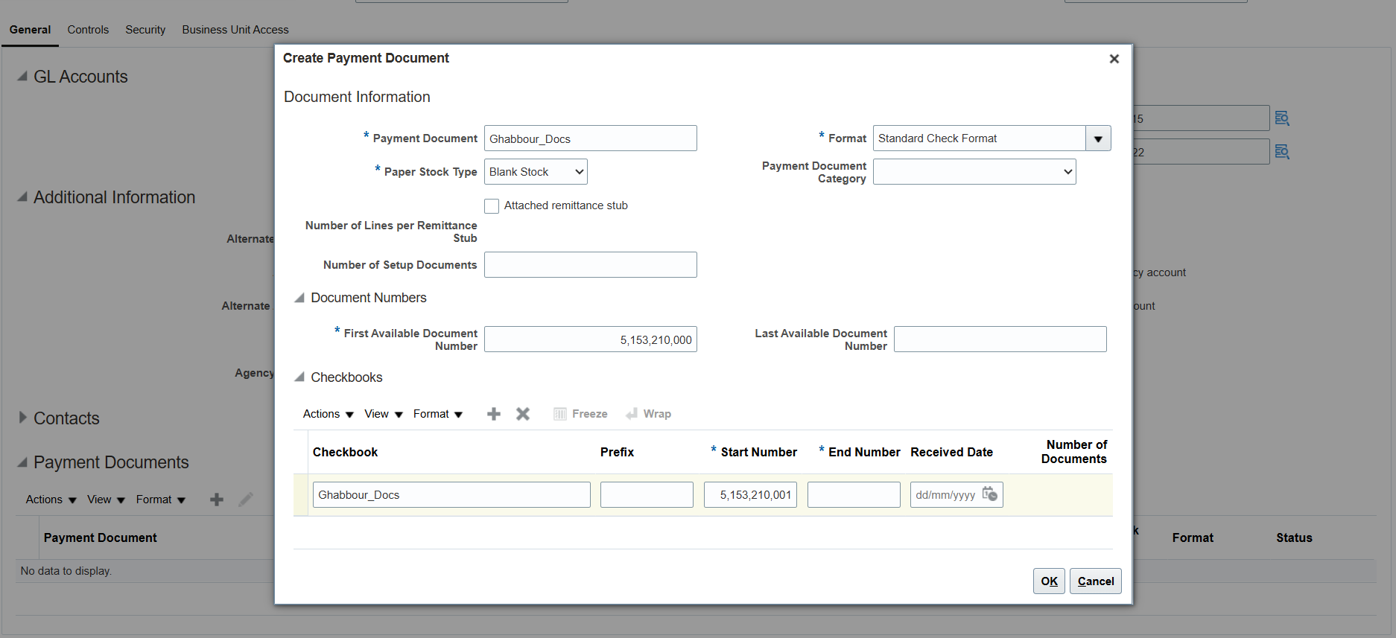
Ahmed Mahmoud Salah
Create Payment Documents

Slide 49
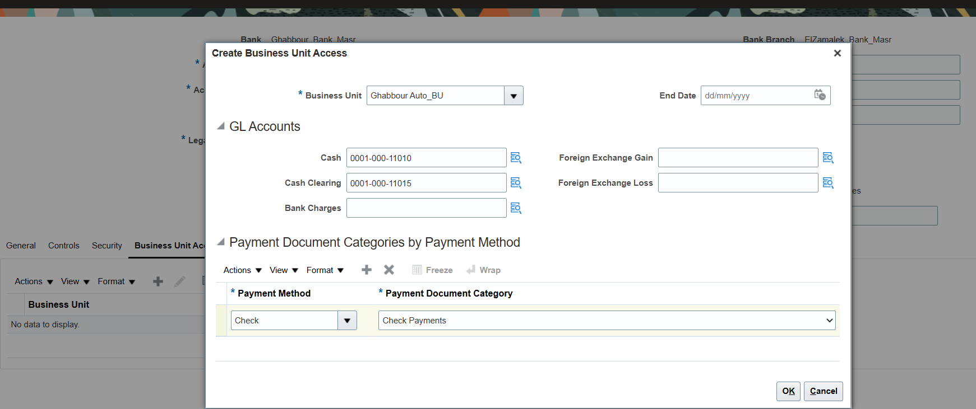
Ahmed Mahmoud Salah
Create BU Access in Bank Account

Slide 50
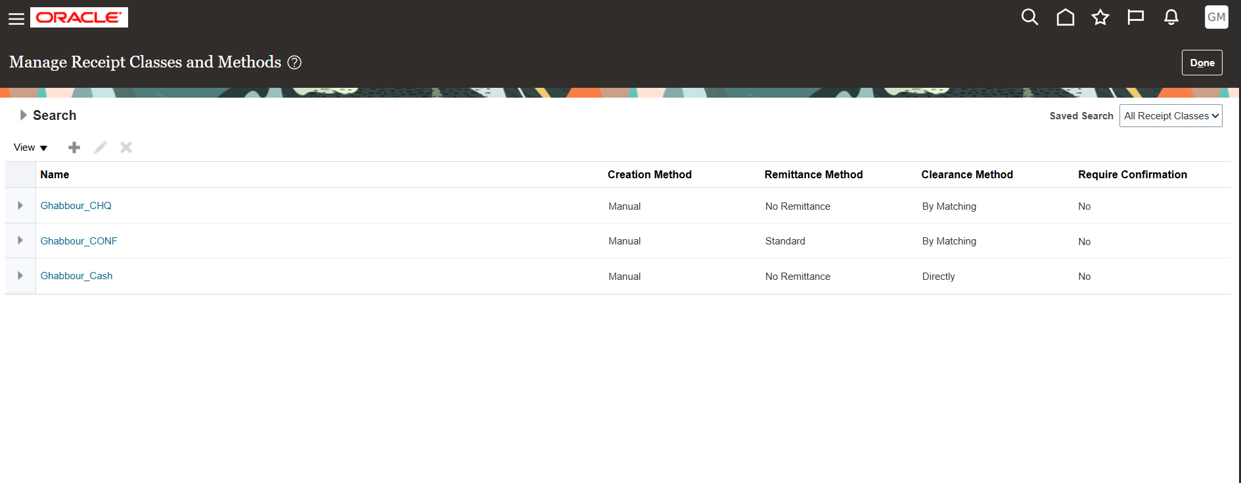
Ahmed Mahmoud Salah
Create Receipt Methods

Slide 51
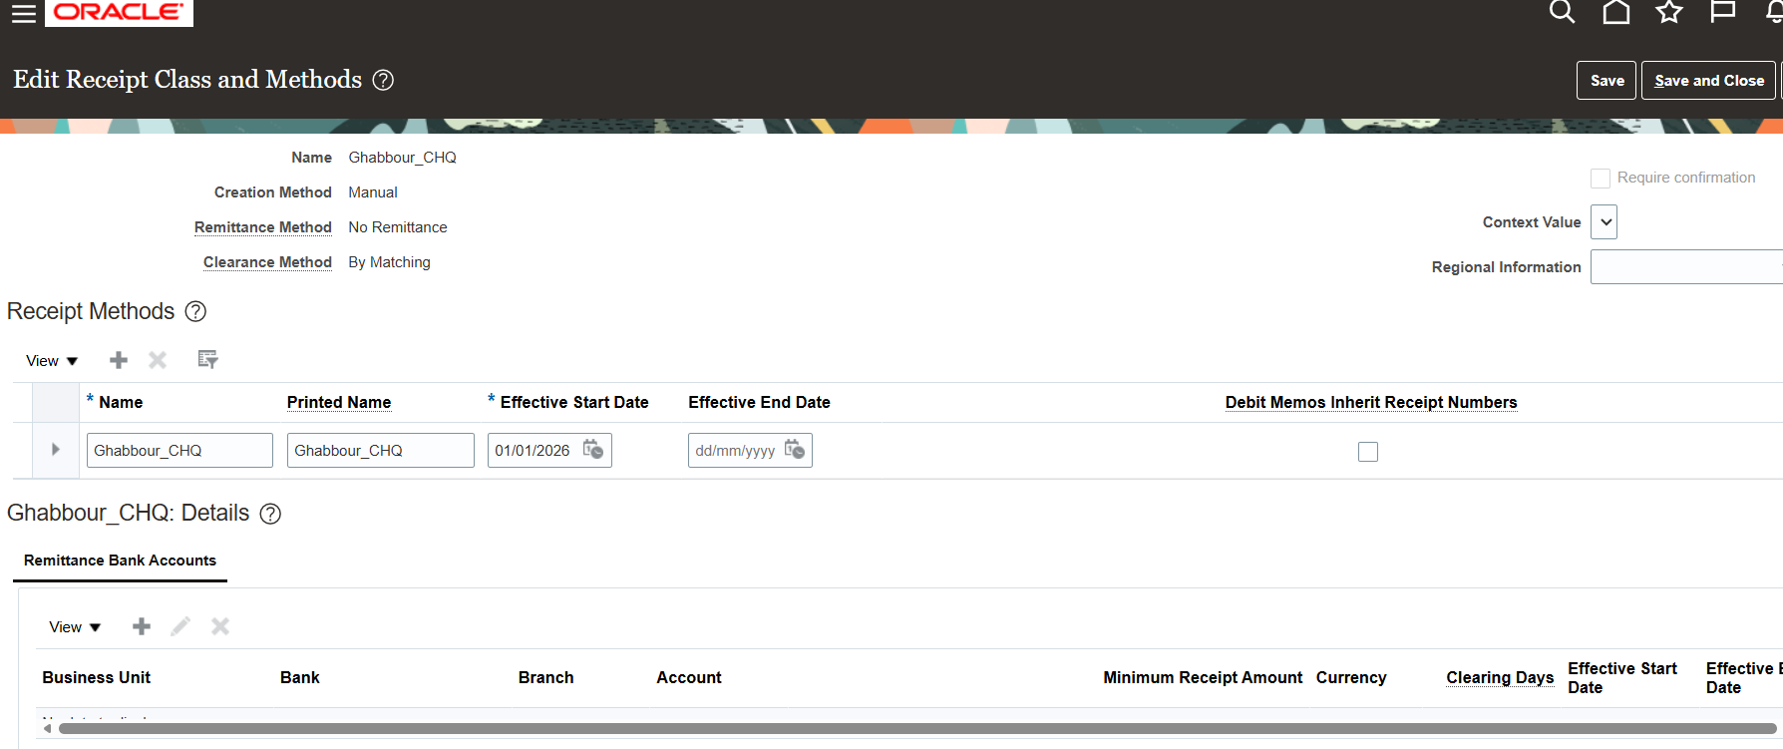
Ahmed Mahmoud Salah
Create Receipt Methods

Slide 52
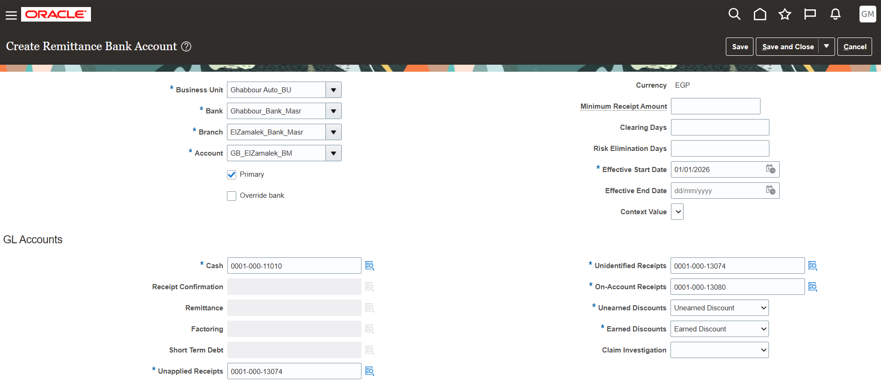
Ahmed Mahmoud Salah
Link the bank to the Receipt Method (Cash)

Slide 53
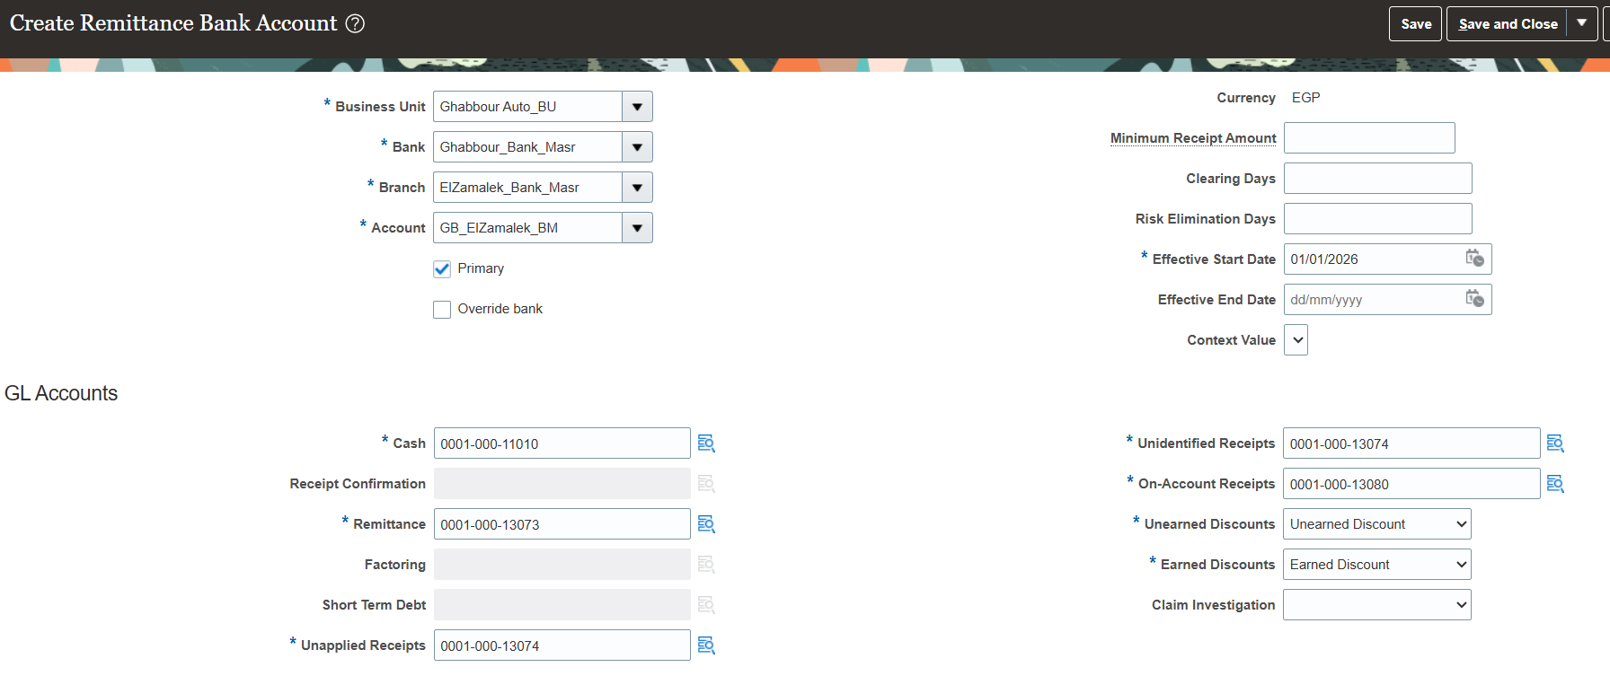
Ahmed Mahmoud Salah
Link the bank to the Receipt Method (Remitted)

Slide 54

Ahmed Mahmoud Salah
Link the bank to the Receipt Method (Confirmed)

Slide 55
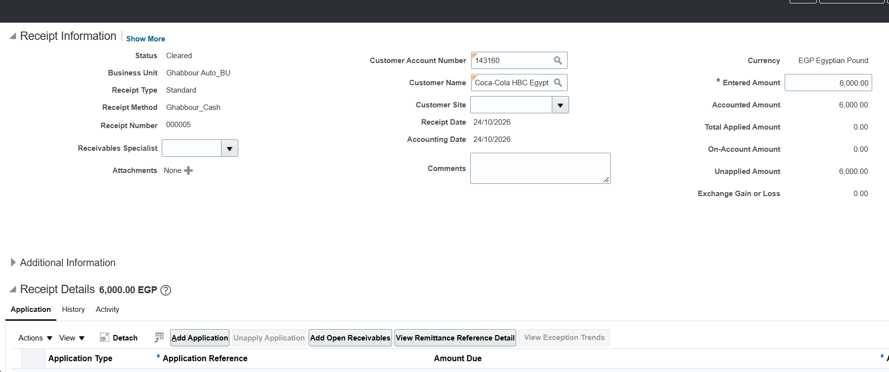
Ahmed Mahmoud Salah
Create Receipt

Slide 56
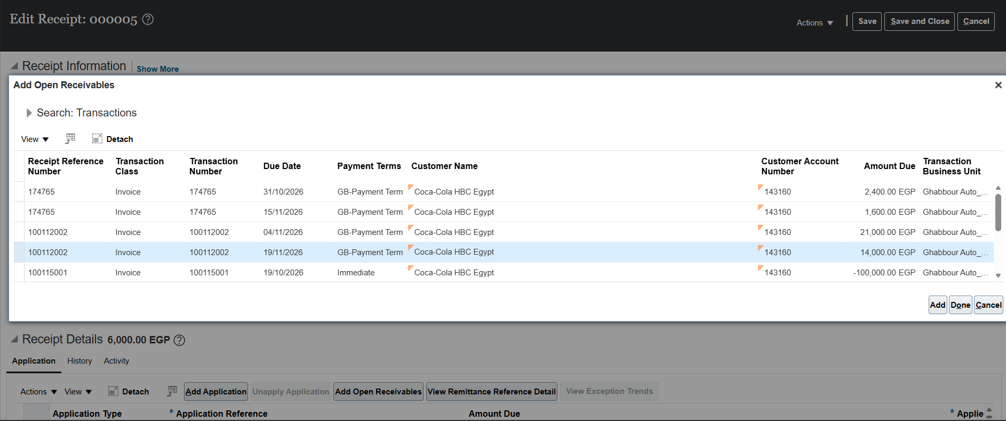
Ahmed Mahmoud Salah
Create Receipt

Slide 57
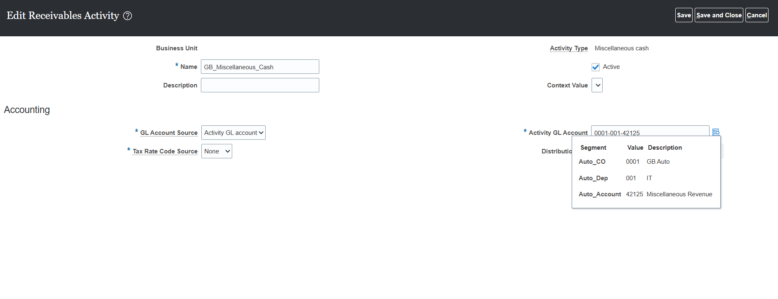
Ahmed Mahmoud Salah
Miscellaneous Cash

Slide 58
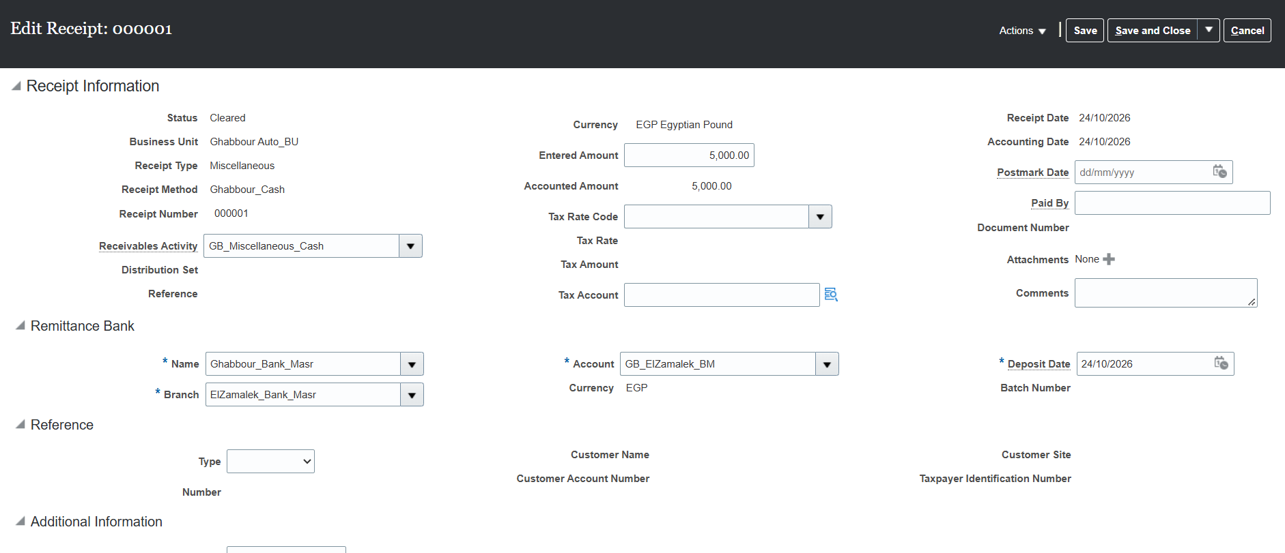
Ahmed Mahmoud Salah
Miscellaneous Cash

Slide 59
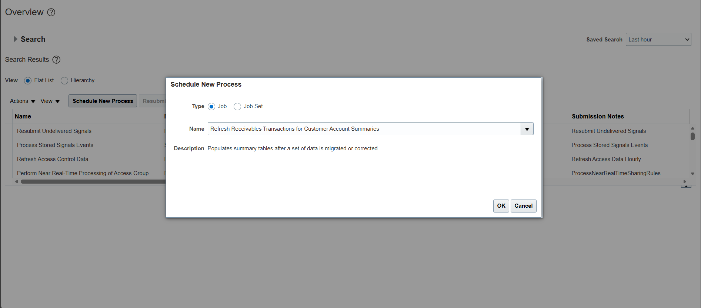
Ahmed Mahmoud Salah
Report

Slide 60

Ahmed Mahmoud Salah
Report

Slide 61
Ahmed Mahmoud Salah
Report

Slide 62
Q/A

Slide 63
Thanks

